Slide 1


Unpredictable Nature of Environment on Nitrogen Supply and Demand
November 2019
ASA
nue.okstate.edu

Slide 2
Maize grain yield for the check (0N), high N treatment and optimum N rate in 26 field experiments , 213 site years of published data, 1958-2010.
Source | Location | Years | Time period | † (0-N) Yield Range | ‡ High N Yield Range | *Optimum N rate kg ha⁻¹
 |  |  |  | ---- Mg ha⁻¹ ---- |  | Min | Max | Avg. | SD
Bundy et al. (2011) | WI | 21 | 1958-1983 | 1.6-7.6 | 4.3-8.8 | 50 | 233 | 130 | 53
Bundy et al. (2011) | WI | 9 | 1984-1997 | 2.7-5.6 | 5.7-9.96 | 58 | 235 | 179 | 51
Mallarino and Torres (2006) | IA | 20 | 1979-2003 | 0.8-5.9 | 5.1-12.4 | 81 | 237 | 165 | 49
Mallarino and Torres (2006) | IA | 14 | 1985-2010 | 1.4-6.2 | 5.3-12.8 | 134 | 239 | 197 | 32
Varvel et al. (2007) | NE | 5 | 1995-2005 | 6.6-10.9 | 10.4-13.3 | 73 | 193 | 131 | 49
Jokela et al. (1989) Carroll | MN | 3 | 1982-1984 | 5.5-7.3 | 7.1-9.1 | 5 | 131 | 84 | 69
Jokela et al. (1989) Webster | MN | 3 | 1982-1984 | 1.7-5.6 | 1.8-8.7 | 70 | 113 | 91 | 21
Fenster et al. (1976) Waseca | MN | 5 | 1970-1975 | 3.2-7.4 | 7.1-10.6 | 60 | 199 | 135 | 50
Fenster et al. (1976) Martin A | MN | 7 | 1970-1976 | 3.8-8.2 | 4.0-9.6 | 23 | 126 | 69 | 36
Fenster et al. (1976) Martin B | MN | 6 | 1971-1976 | 6.2-11.3 | 6.2-12.0 | 0 | 37 | 18 | 15
Al Kaisi et al. (2003) | CO | 3 | 1998-2000 | 5.6-10.2 | 8.3-10.8 | 66 | 111 | 91 | 23
Ismail et al. (1994) NT | KY | 20 | 1998-2000 | 2.1-7.4 | 5.2-10.9 | 35 | 230 | 128 | 46
Ismail et al. (1994) CT | KY | 20 | 1970-1990 | 1.9-9.5 | 3.5-10.4 | 0 | 203 | 98 | 52
Rice et al. (1986) NT | KY | 15 | 1970-1985 | 3.1-4.9 | 5.7-9.2 | 102 | 178 | 144 | 30
Rice et al. (1986) CT | KY | 15 | 1970-1985 | 1.9-6.1 | 5.0-8.8 | 69 | 204 | 124 | 47
Stecker et al. (1993) Columbia | MO | 3 | 1988-1990 | 3.3-5.6 | 6.0-10.1 | 99 | 194 | 153 | 49
Stecker et al. (1993) Novelty | MO | 3 | 1988-1990 | 4.5-7.2 | 6.7-9.9 | 45 | 182 | 103 | 71
Stecker et al. (1993) Corning | MO | 2 | 1989-1990 | 5.0-6.0 | 8.2-8.5 | 90 | 117 | 104 | 20
Peterson et al. (1989) | NE | 4 | 1983-1986 | 2.1-6.4 | 3.9-10.0 | 11 | 218 | 104 | 88
Eck (1982) | TX | 2 | 1977-1978 | 2.7-4.4 | 5.6-5.9 | 59 | 116 | 88 | 40
Shapiro et al. (2006) RS 51cm | NE | 3 | 1996-1998 | 6.2-8.9 | 9.4-11.1 | 69 | 96 | 83 | 13
Shapiro et al. (2006) RS 76cm | NE | 3 | 1996-1998 | 5.0-8.9 | 7.1-11.0 | 13 | 114 | 75 | 54
Meisinger et al. (1985) MT | MD | 4 | 1974-1977 | 1.8-2.6 | 5.8-8.2 | 127 | 233 | 183 | 45
Meisinger et al. (1985) PT | MD | 4 | 1974-1977 | 2.7-4.2 | 5.1-8.1 | 36 | 196 | 142 | 75
Gehl et al. (2005) Rossville | KS | 2 | 2001-2002 | 6.4-7.9 | 11.3-12.6 | 182 | 204 | 193 | 15
Gehl et al. (2005) Scandia | KS | 2 | 2001-2002 | 2.7-7.4 | 3.8-11.5 | 51 | 160 | 105 | 77
Total |  | 198 |  |  | Average | 62 | 173 | 120 | 45
 |  |  |  |  | SD | 44 | 55 | 43 | 20
range in the recorded maize grain yields for the check plot where no N was applied
‡ - range in the recorded maize grain yields for the high N rate treatment in each experiment. These high N rates ranged from 1.8 to13.3 Mg ha⁻¹
* - optimum N rates determined by subtracting the yield the check (0N) treatment from the yield in the high N treatment, multiplying by a known N concentration, and dividing by a fixed nitrogen use efficiency (NUE), set at 0.33

Slide 3
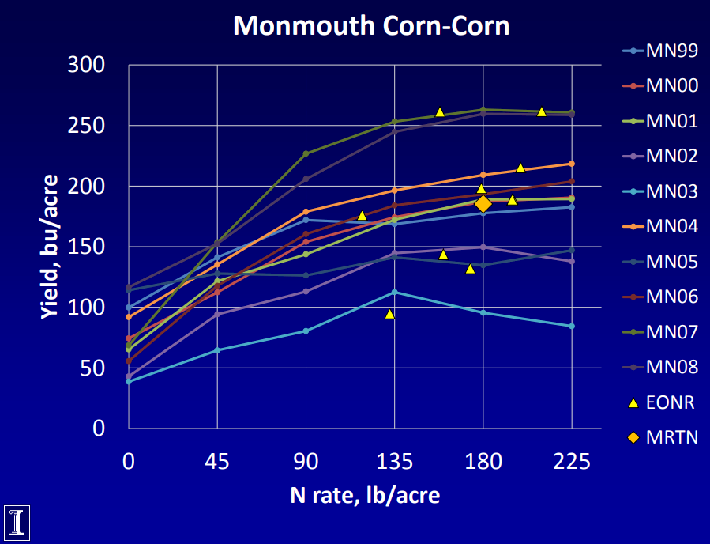
Nafziger, 2019

Slide 4
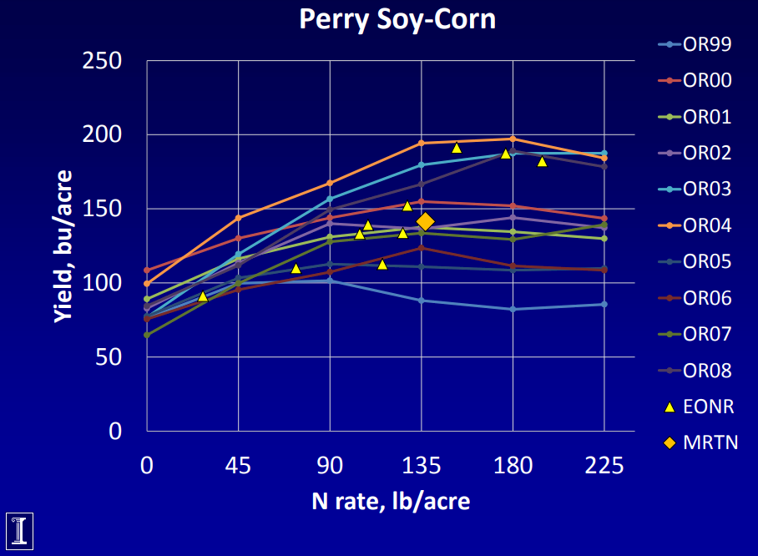
Nafziger, 2019

Slide 5
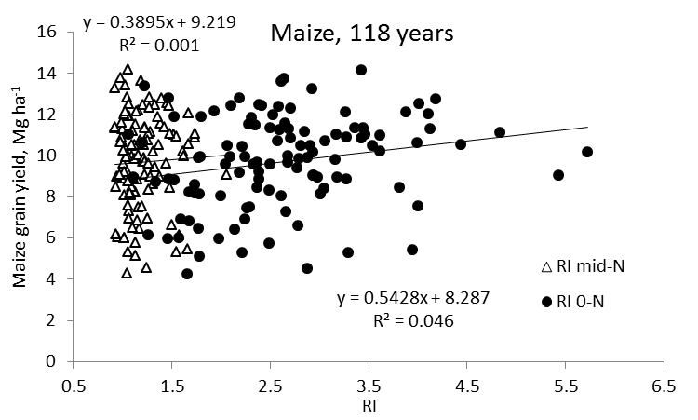
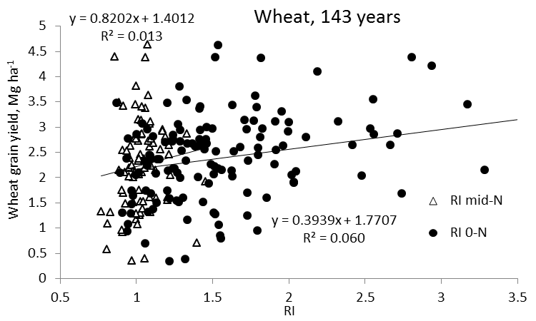
Independence of Yield potential and Nitrogen response
Iowa
Nebraska
Wisconsin
Oklahoma
2013. Relationship between grain crop yield potential and nitrogen response. Agron. J. 105:1335–1344.
Independence of yield potential and crop nitrogen response. Precision Agric. 12:508-518.

Slide 6
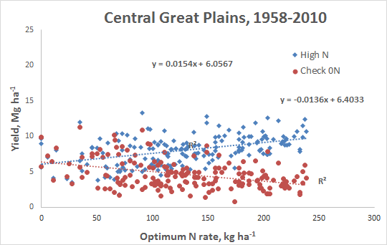

Slide 7
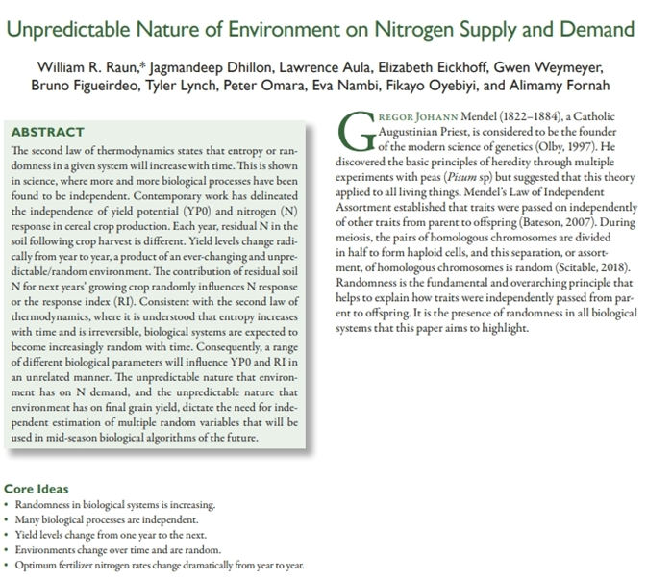
doi:10.2134/agronj2019.04.0291

Slide 8
Randomness is increasing. This is revealed in findings that more and more processes are independent.
Recent work documented the independence of yield potential (YP0) and nitrogen (N) response in cereal crop production.
Each year, residual N in the soil following crop harvest is different.
Yield levels change radically from year to year, a product of an ever-changing and unpredictable/random environment.
The contribution of residual soil N for next years’ growing crop, randomly influences N response or the response index (RI).
Consistent with the 2nd law of thermodynamics (entropy or orderliness increases with time and is irreversible), biological systems are expected to become more and more random with time.
Range of different biological parameters influence YP0 and RI in an unrelated manner. Unpredictable nature that environment has on N demand, and the unpredictable nature that environment has on grain yield, dictate the need for independent estimation of multiple random variables that will be used in mid-season biological algorithms of the future.

Slide 9
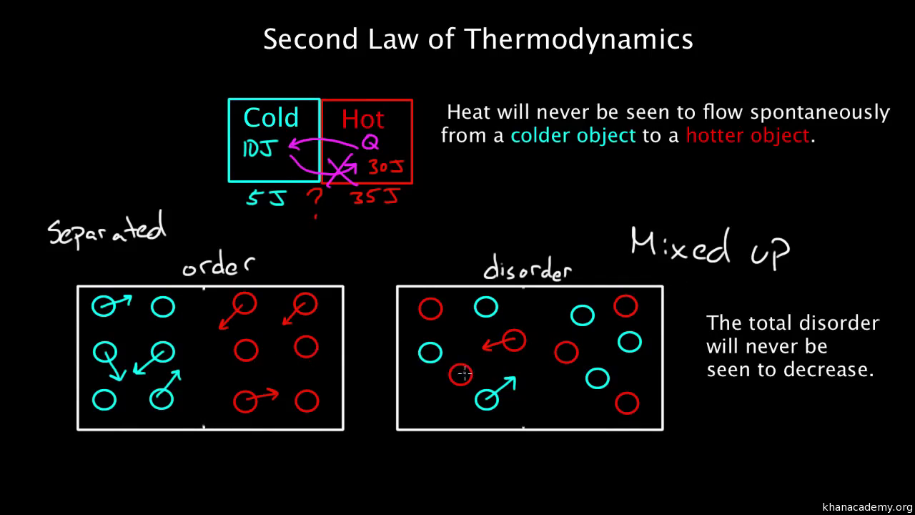

Slide 10
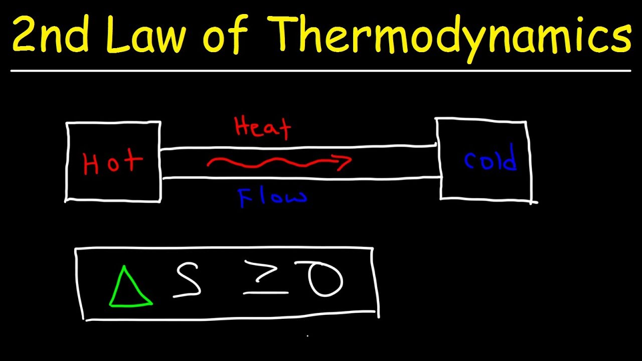
In an irreversible process, entropy always increases, so the change in entropy is positive. The total entropy of the universe is continually increasing.
Delta S is entropy. It's a measurement of randomness or disorder. Notice I havedeltas in front of these. That's because we typically talk about changes, reactions or processes that actually happen in Chemistry. ... We can only measure the change it undergoes through a chemical process

Slide 11
Gregor Johann Mendel (1822 – 1884) Catholic Augustinian Priest, founder of the modern science of genetics (Olby, 1997). Discovered the basic principles of heredity via experiments with peas (Pisum sp) but suggested that this theory applied to all living things.
Mendel’s Law of Independent Assortment established that traits were passed on independently of other traits from parent to offspring (Bateson, 2007).
Random is the fundamental/overarching principle that helps to explain how traits were independently passed from parent to offspring. It is the presence of randomness in all biological systems that this paper highlights
Olby, R.C., 1997. Mendel, Mendelism and genetics. Mendel-Web, URL: www. netspace. org/MendelWeb/MWolby. intro. html.
Bateson, W., 2007. Mendel's principles of heredity. Cosimo, Inc.

Slide 12
Yield Potential (YP0) and N response or Response Index (RI) were reported to be independent by Raun et al. (2011), using 90 site-years of winter wheat data. Ensuing work by Arnall et al. (2013) coming from 261 site-years of both maize and wheat data, further documented the validity of this finding.
yield level from one year to the next was documented to be random and unpredictable, while the response to fertilizer N year to year was also random (Dhital and Raun 2016; Lamb et al., 1997).
Arnall, Because both affect the demand for fertilizer N, independent estimates of both were suggested to calculate realistic in-season fertilizer N rates.
Dhital, S., and W. R. Raun. 2016. Variability in Optimum Nitrogen Rates for Maize. Agron. J. 108:2165-2173. doi:10.2134/agronj2016.03.0139
Lamb, J. A., R. H. Dowdy, J. L. Anderson, and G. W. Rehm. 1997. Spatial and Temporal Stability of Corn Grain Yields. J. Prod. Agric. 10:410-414. doi:10.2134/jpa1997.0410.

Slide 13
Entropy and Randomness
Early work by Mann (1970) recognized randomness in fundamental biological processes and organic evolution. He further suggested that randomness is inherent in the natural process. Entropy is also a gauge of randomness or chaos within a closed system. As usable energy is irretrievably lost, disorganization, randomness, and chaos increase (https://www.allaboutscience.org/second-law-of-thermodynamics.htm, visited June 19, 2018). This is aligned with the second law of thermodynamics that embeds knowledge that the total entropy of an isolated system can never decrease over time, where entropy is the degree of disorder or randomness in the system (Costa et al., 2002).
Mann, J. C. (1970). Randomness in Nature. GSA Bulletin ; 81 (1): 95–104. doi: https://doi.org/10.1130/0016-7606(1970)81[95:RIN]2.0.CO
Costa, M., A. L. Goldberger, and C.K. Peng. 2002. Multiscale entropy analysis of complex physiologic time series. Physical Review Letters: 89(6) 68-102.

Slide 14
Heams (2014) reported that randomness is in many ways, an inherent feature of evolutionary biology and genetics. This is reflected in work by Lee (2002), who noted that the invasion success of many species depends on their ability to respond to natural selection. Wang et al. (2016) summarized that the second law of thermodynamics states that a system progresses in the direction of increasing entropy, where a system includes engineered devices as well as biological organisms and that entropy is a measure of randomness. He further noted that a system naturally progresses from non-randomness to randomness.
Udgaonkar (2001) observed that the second law of thermodynamics does not distinguish between living and non-living things, further observing that the concepts of thermodynamics constitute the unifying principles of physics, chemistry, and biology.
Heams, T.. 2014. Randomness in biology. Mathematical Structures in Computer Science, 24(3), E240308. doi:10.1017/S096012951200076X
Udgaonkar, J.B., 2001. Entropy in biology. Resonance 6: 61-66. https://doi.org/10.1007/BF02837738

Slide 15
Udgaonkar (2001) also communicated that the second law of thermodynamics implies that the principle of total entropy, as a measure of disorder, must steadily increase. This acknowledgement that included biology, further ties the second law of thermodynamics to plant and crop production systems. Heams (2014) commented on the need for a reappraisal of the status of randomness in life sciences, and that have important consequences for research strategies in theoretical and applied biology.
Udgaonkar, J.B., 2001. Entropy in biology. Resonance 6: 61-66. https://doi.org/10.1007/BF02837738

Slide 16
2nd law of thermodynamics helps to explain why ostensibly similar biological components (RI and YP0) were independent (Arnall et al., 2013; Raun et al., 2011). This law delineates that everything is becoming more and more random with time.
Considering Mendel’s Law of Independent Assortment (traits passed on independently), and the 2nd law of thermodynamics, the overarching impact/influence of randomness on all biological properties, leads to understanding that any one of these biological variables should not be related.

Slide 17
The terms stochastic process and random process are used interchangeably. Randomness is the lack of pattern or predictability. Saunders and Ho (1976) noted that a striking feature of evolution is that it tends to produce organisms which are more and more complex, as such more and more random.
Systems do not necessarily tend toward chaos, but to a situation that is inherently unstable and unpredictable. At any given moment, random variations occur with varying consequences and varying degrees of predictability (Spielman et al., 2009).
Olson et al. (1976) showed that residual mineral N influenced both wheat and corn grain protein levels, and that was noticeably different by environment. Raun et al. (2017), noted an unpredictable environmental influence on grain yields and suggested predicting mid-season yield potential using optical sensors to improve in-season cereal fertilizer N recommendations, over that of yield goals.
A consequence of unpredictable weather effects on crop requirements has been to use reference plots (high N rates) and crop sensing before in-season N application (Tremblay and Belec, 2006). This is bound to the understanding that weather (particularly rainfall in dryland production systems) is the primary driver for both plant growth and soil nutrient availability, and that weather changes dramatically year to year.
Saunders, P.T., and M.W. Ho. 1976. On the increase in complexity in evolution. J. Theo. Biol. 63: 375-384.
Spielman, D.F., J. Ekboir, and K. Davis. 2009. The art and science of innovation systems inquiry: Applications to Sub-Saharan African agriculture. Tech. in Society: 3:399-405
Olson, R. A., K. D. Frank, E. J. Deibert, A. F. Dreier, D. H. Sander, and V. A. Johnson. 1976. Impact of Residual Mineral N in Soil on Grain Protein Yields of Winter Wheat and Corn. Agron. J. 68:769-772. doi:10.2134/agronj1976.00021962006800050021x
Tremblay, N., and C. Belec. 2006. Adapting nitrogen fertilization to unpredictable seasonal conditions with the least impact on the environment. Horticulture Technology, 16:408-412.

Slide 18
Arnall et al. (2013) further demonstrated the randomness and inconsistency of N response over time, and that was observed in all long-term experiments in their paper, coming from Iowa, Nebraska, Wisconsin, and Oklahoma. They estimated N response using a Response Index (RI), by dividing grain yield in the adequately fertilized plots by grain yield in the unfertilized plots.
One of the reasons that yield potential and N response are independent is because residual N from the previous year is always different, and likely random due to last year’s environment (Jokela and Randall 1989). The contribution of residual N for the ensuing year then impacts the ensuing years’ RI, randomly, but that doesn’t necessarily impact yield level unless it was a good year (no moisture stress).
Jokela, W.E., and G.W. Randall. 1989. Corn yield and residual soil nitrate as affected by time and rate of nitrogen application. Agron. J. 81:720-726

Slide 19
The unpredictable nature that environment has on N demand and the unpredictable nature that environment has on final yield dictate that both be estimated independently of one another.
Algorithms of the future are likely to take on independent estimates of more and more properties. If these individual properties are known to impact and affect the output parameter (e.g., estimate of fertilizer N rate), each should be estimated independently because they are becoming more and more random with time.

Slide 20
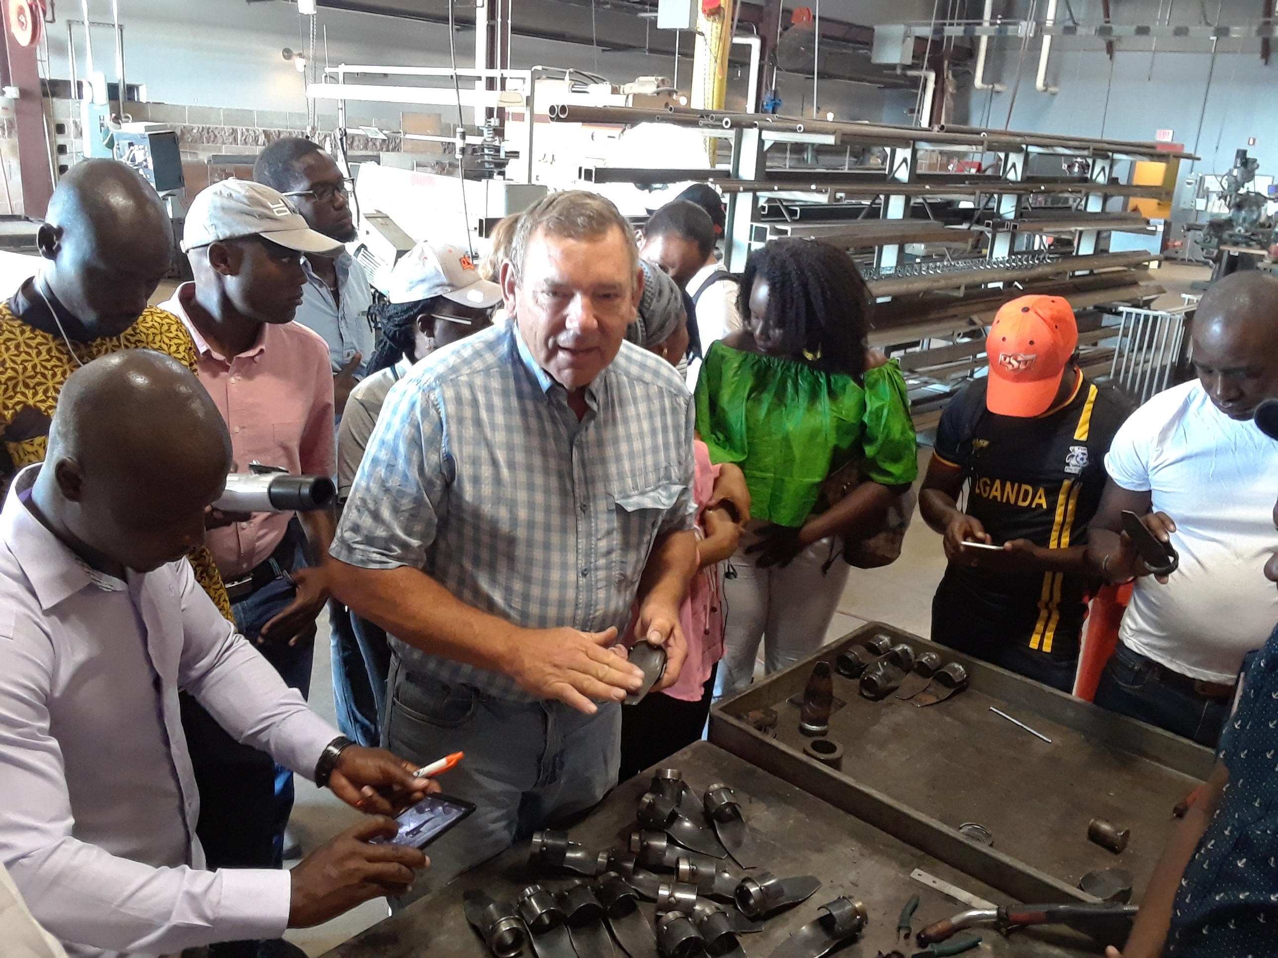
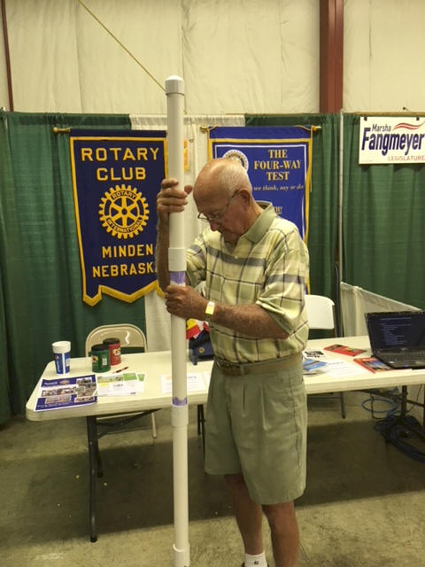
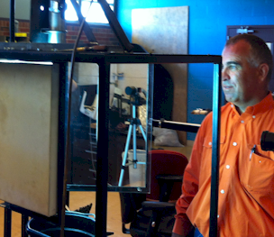

Wayne Kiner
Institutional Memory
Kearney County Fair
Minden, Nebraska
Randy Taylor
tolerance testing
Koemel Law, PLLC
205 W. 7th Ave.
Suite 101-B
Stillwater, OK 74074
http://nue.okstate.edu/Hand_Planter.htm

Slide 21







Frontier Rotary, Stillwater Oklahoma
Stillwater Centennial, Stillwater, Oklahoma
Mustang Rotary, Mustang, Oklahoma
Minden Rotary, Minden, Nebraska
Kearney Rotary, Kearney, Nebraska
District 5750, Oklahoma
District 5630, Nebraska
District 9211, Uganda

Slide 22
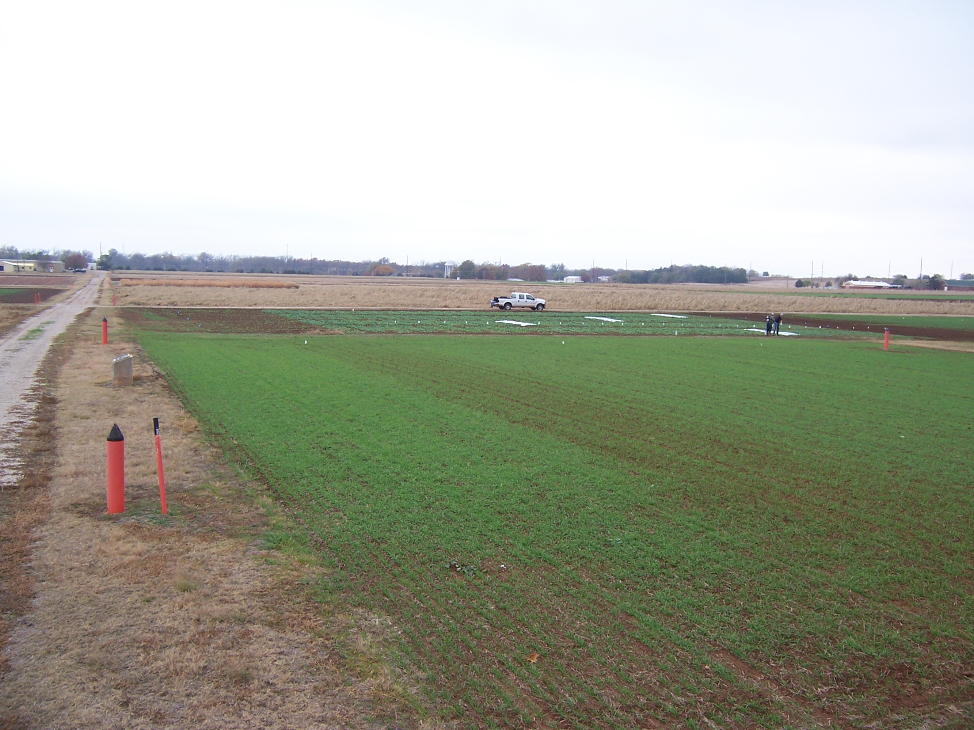
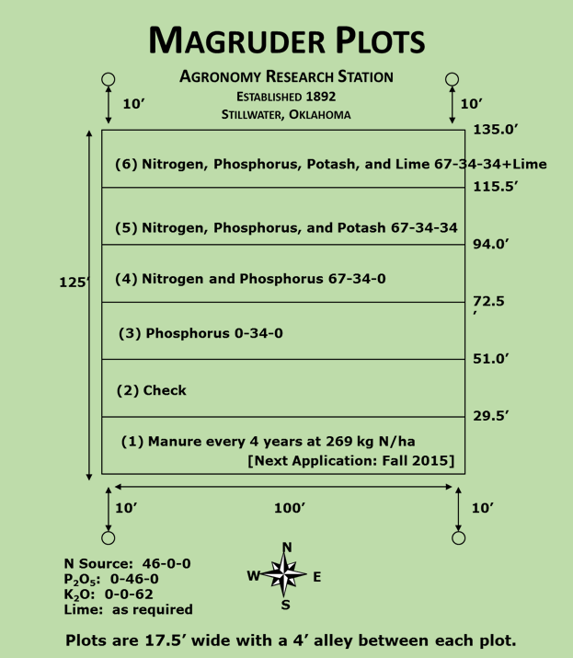

Magruder Plots
Free living cyanobacteria (blue green algae) found in the check plot.
Sun, et al., 2004. Bacterial community structure and diversity in a century-old manure-treated agroecosystem. Appl. Environ. Micro. 70:5868-5874.
1892

Slide 23
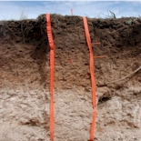
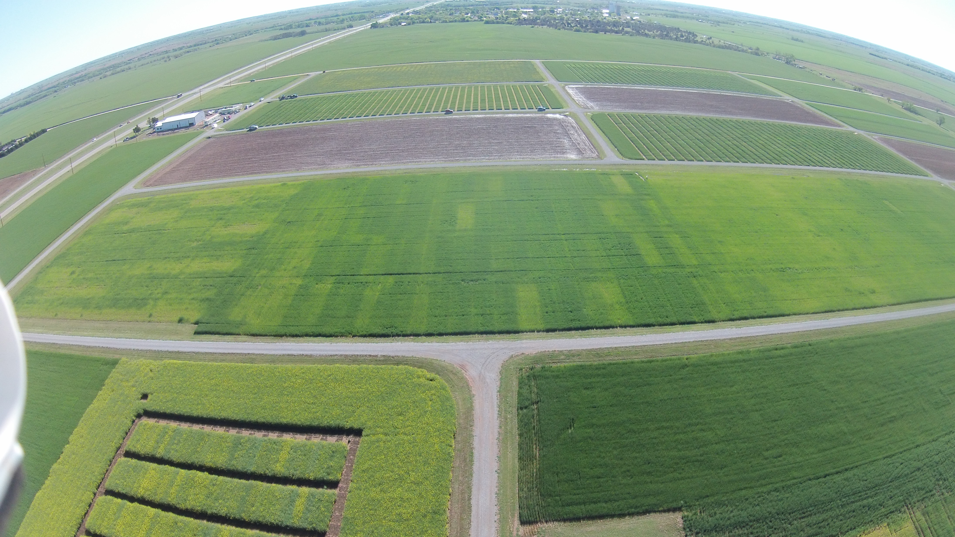
Wheat Fertility Experiment No.502
North Central Experiment Station
Established 1970
Location: Lahoma
TRT | Pre-plant N rate (lb N / ac) | Pre-plant P rate (lb P₂O₅ / ac) | Pre-plant K rate (lb K₂O / ac)
1.* | 0 | 0 | 0
2.* | 0 | 40 | 60
3.* | 20 | 40 | 60
4.* | 40 | 40 | 60
5.* | 60 | 40 | 60
6.* | 80 | 40 | 60
7.* | 100 | 40 | 60
8. | 60 | 0 | 60
9. | 60 | 20 | 60
10. | 60 | 60 | 60
11. | 60 | 80 | 60
12. | 60 | 60 | 0
13. | 100 | 80 | 60
14. | 60 | 40 | 60 (Sul-Po-Mag)
N applied as 46-0-0 (Urea) P applied as 0-46-0 (Triple Super Phosphate) K applied as 0-0-60 (Potash) * - YP plot
Grant silt loam (fine-silty, mixed, superactive, thermic, Udic Argiustoll
Plot size: 16’ x 60’
Alley: 20’
Total Trial Area: 224’ x 300’
W
S
N
E
OBJECTIVE: To study fertilizer nitrogen, phosphorus, and potassium in winter wheat. In recent years, this study has also been used to develop yield potential models and yield predictions through sensor based technologies.
1, 2 – Harvest Sequence Number
1, 2 – Treatment Number
1 , 2 – Soil Sample Sequence Number
 | 300 | 4 | 5 | 12 | 13 | 20 | 21 | 28 | 29 | 36 | 37 | 44 | 45 | 52 | 53
Rep 4 |  | 3 | 5 | 13 | 6 | 10 | 2 | 4 | 7 | 12 | 1 | 8 | 14 | 9 | 11
 | 240 | 43 | 44 | 45 | 46 | 47 | 48 | 49 | 50 | 51 | 52 | 53 | 54 | 55 | 56
 | 220 | 3 | 6 | 11 | 14 | 19 | 22 | 27 | 30 | 35 | 38 | 43 | 46 | 51 | 54
Rep 3 |  | 1 | 14 | 2 | 7 | 11 | 3 | 9 | 12 | 5 | 13 | 4 | 8 | 10 | 6
 | 160 | 29 | 30 | 31 | 32 | 33 | 34 | 35 | 36 | 37 | 38 | 39 | 40 | 41 | 42
 | 140 | 2 | 7 | 10 | 15 | 18 | 23 | 26 | 31 | 34 | 39 | 42 | 47 | 50 | 55
Rep 2 |  | 4 | 8 | 3 | 1 | 11 | 13 | 12 | 7 | 14 | 6 | 9 | 10 | 2 | 5
 | 80 | 15 | 16 | 17 | 18 | 19 | 20 | 21 | 22 | 23 | 24 | 25 | 26 | 27 | 28
 | 60 | 1 | 8 | 9 | 16 | 17 | 24 | 25 | 32 | 33 | 40 | 41 | 48 | 49 | 56
Rep 1 |  | 8 | 2 | 4 | 6 | 14 | 9 | 10 | 5 | 7 | 12 | 1 | 3 | 13 | 11
 |  | 1 | 2 | 3 | 4 | 5 | 6 | 7 | 8 | 9 | 10 | 11 | 12 | 13 | 14
 | 0 | 16 | 32 | 48 | 64 | 80 | 96 | 112 | 128 | 144 | 160 | 176 | 192 | 208 | 224
1970

Slide 24
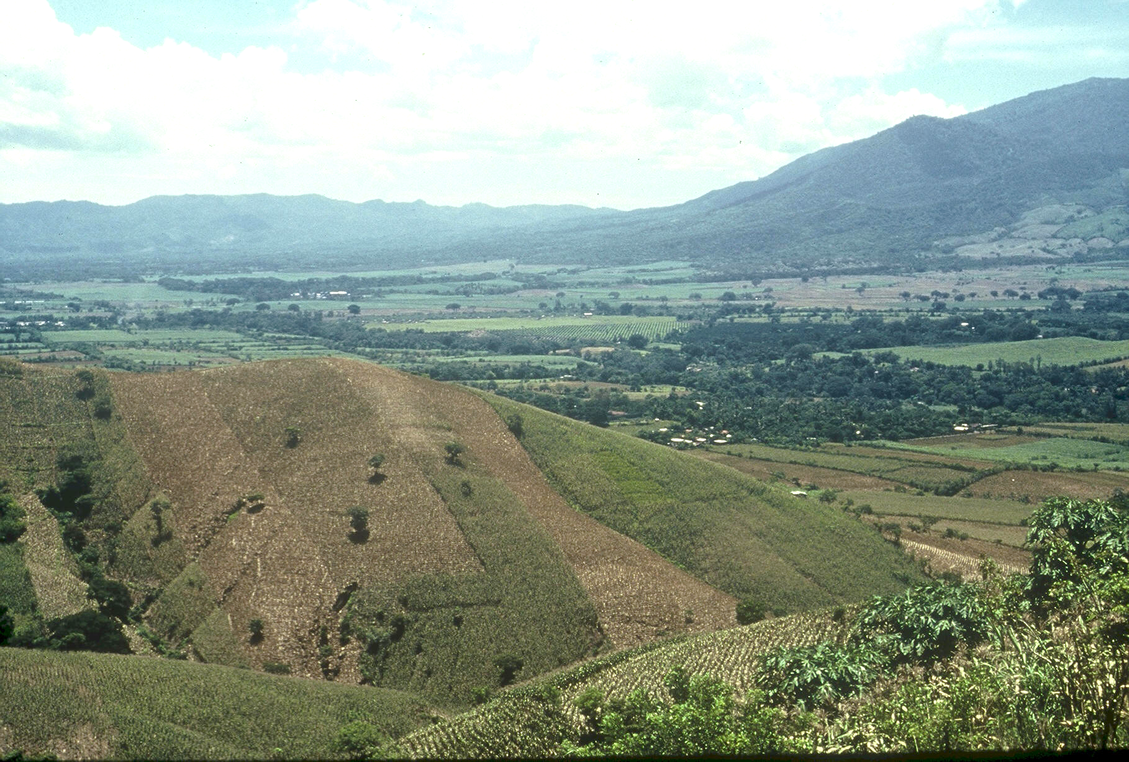

Planter Chronology
1985, CIMMYT
1987, Regional Agronomist Central America
1991, Faculty OSU
1999, FP - Hand Planter work
2000, Working prototype
2013, MS, Aula, Omara
2019, Planter redesign, Rotary Grant / Importance
32 years
Rotary Contributions
(OK, NE, Uganda)

Slide 25

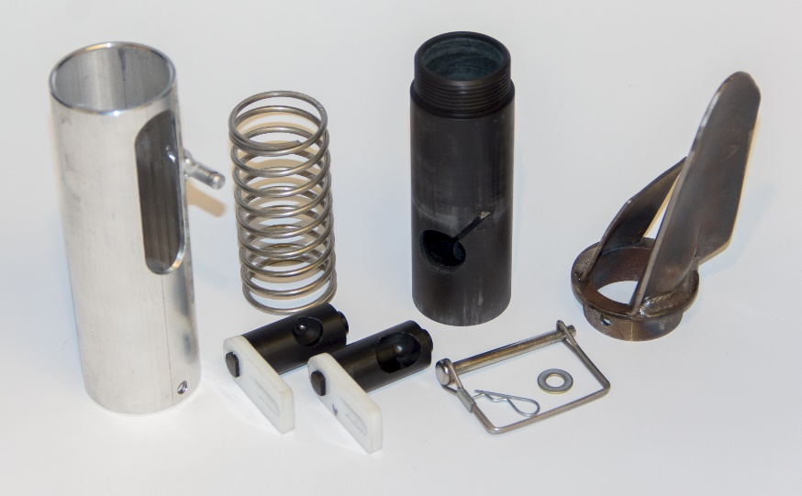
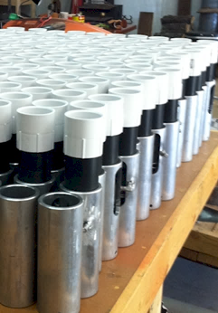

Slide 26
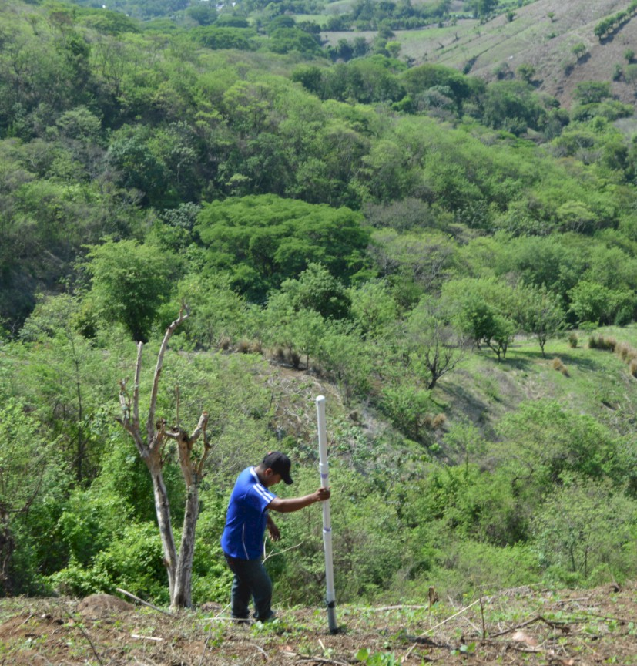
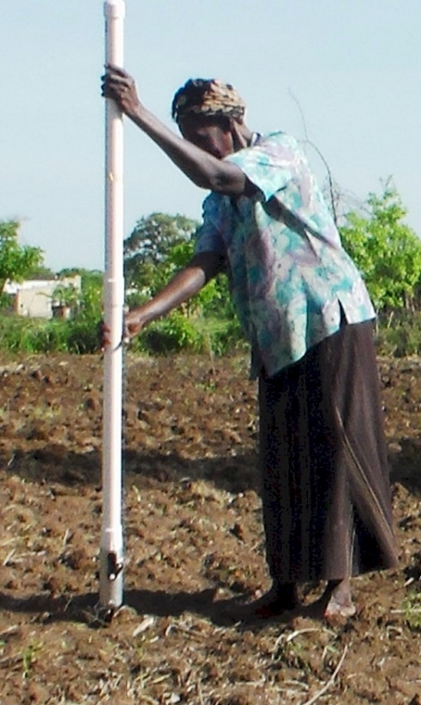
Opico Quezaltepeque, El Salvador
LIRA UGANDA
EL SALVADOR
Peter Omara MS 2013
Worlds Apart
Avg. Farm Size: 1 ha
Avg. Maize Grain Yield, 2 Mg/ha
Maize seed, Hybrids (US, others)
Social aspects/technology transfer

Slide 27
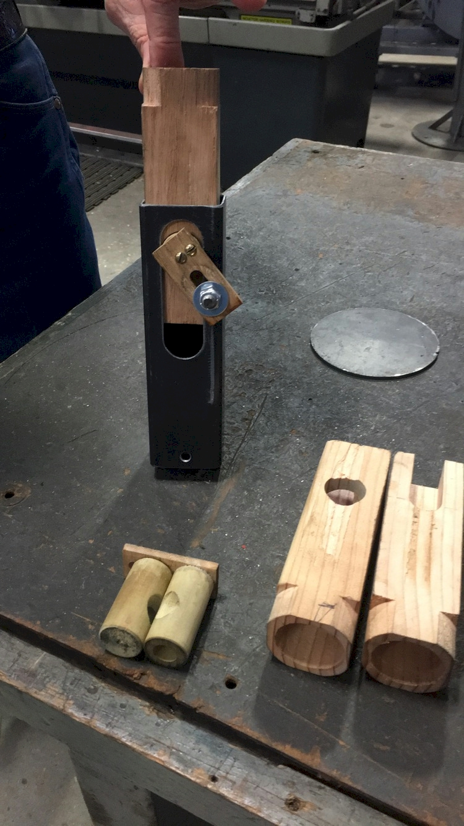
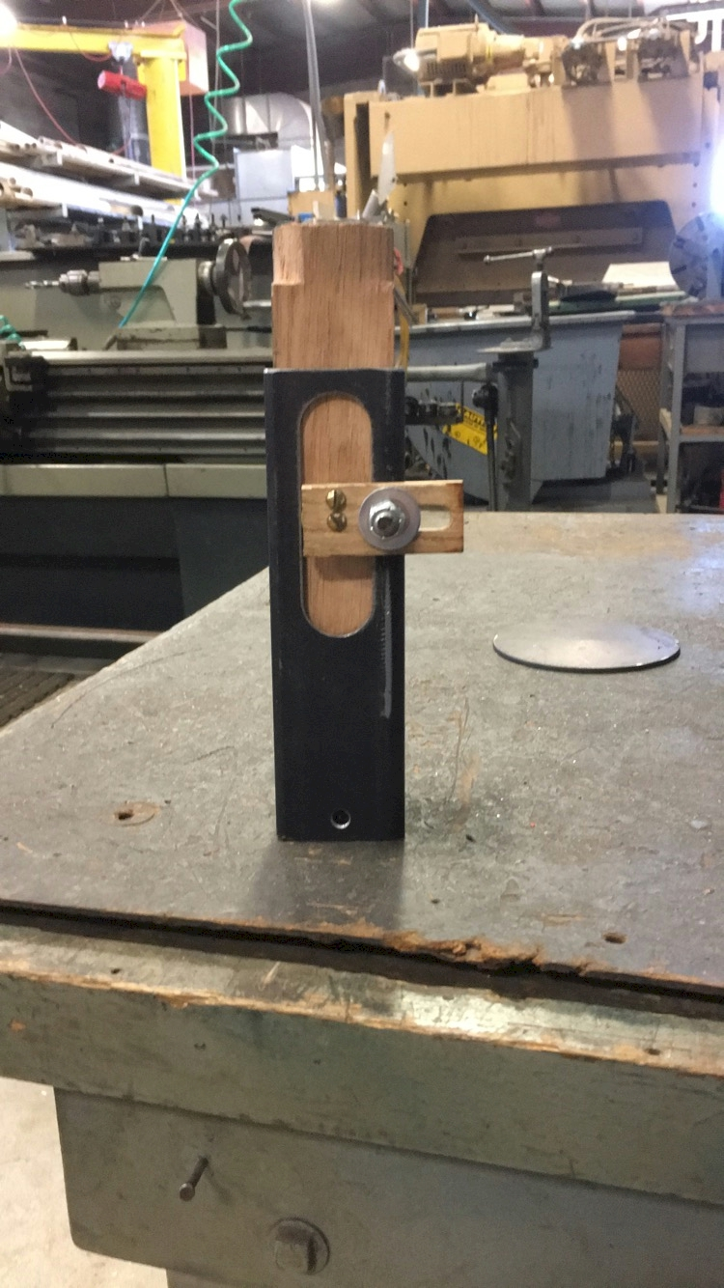

$

Slide 28
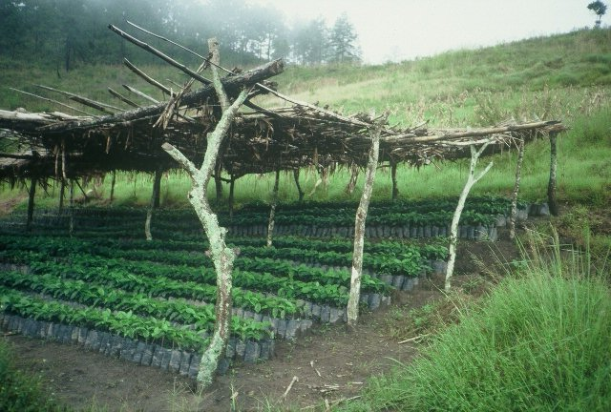
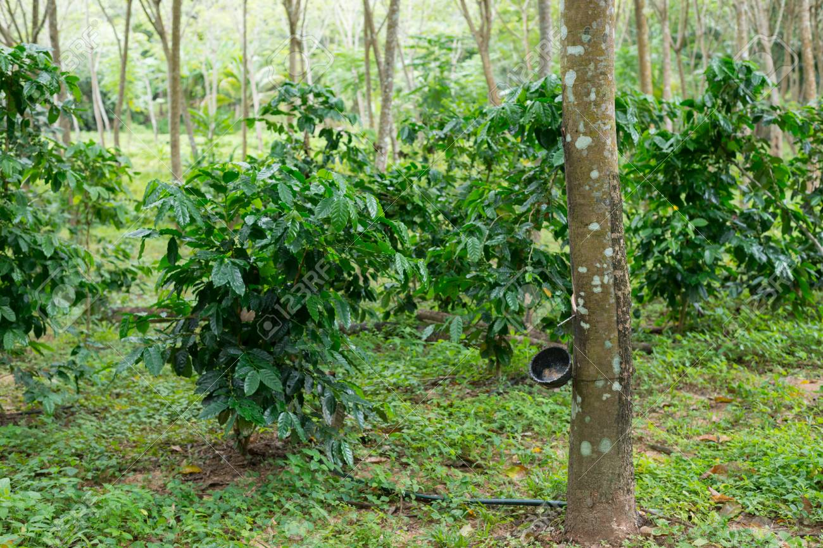
Hemileia vastatrix, leaf rust
(more at lower altitudes)
Coffee Imports to the US (2017)
Colombia $1.3 B
Brazil $1.1 B
Vietnam $541 M
Guatemala $336 M
Indonesia $319 M
Honduras $297 M
Nicaragua $295 M
Peru $227 M
Mexico $225 M
2500-6000 ft asl
Coffee Coffea arabica
Rubber Hevea brasiliensis, 1940 USDA

Slide 29



Norman Borlaug Mother Teresa
1914 – 2009 1910 - 1997

Slide 30



Dr. Robert L. Westerman
Opportunity

Slide 31
13.3 million acres of corn IA
9.5 million acres of corn NE (200 bu/ac irrigated, 147 bu/ac dryland)
7.6 million acres of wheat, KS (48 bu/ac) 2017
5.3 million acres of wheat, OK (39 bu/ac) 2015
1.0 million acres of wheat, NE, (46 bu/ac) 2017
5.7 million acres of soybeans, NE (58 bu/ac) 2017
12.6 million cattle (cows + CAFO’s Texas)
6.6 million cattle (cows + CAFO’s Nebraska)
5.1 million cattle (cows + CAFO’s Oklahoma)
John Deere invented the steel plow in 1837, Barbed wire 1874, extensive tillage/first tractor, 1892 (John Froelich, Clayton County IA)
Atmospheric CO2, 1880 (290 ppm)
Atmospheric CO2, 2018 (408 ppm)
Animal agriculture accounts for 18% of all GHG emissions (CO₂ equivalent, CH₄=20x that of CO₂, N₂O=300x that of CO₂)
Tillage 1890 forward, responsible for 25% of the CO₂ increase
Population
Nebraska 1.92
Kansas 2.78
Iowa 3.03
Oklahoma 3.93

Slide 32
