Slide 1
Carbon Cycle
Katy Layman
Both cycles are meant to be layered on top of each other; similar parts of both cycles align with each other

Slide 2
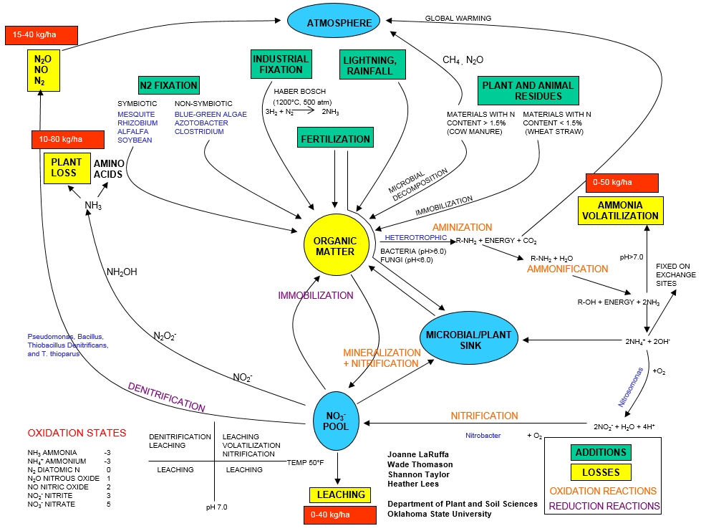

Slide 3
852 GT C
Atmosphere
Fossil Burning
6 GT C
Microbial Decomposition
30 GT C
Fossil Fuels
Photosynthesis
120 GT C
Microbial Decomposition
30 GT C
10,000 GT C
Plant Respiration
Organic Matter
60 GT C
1,500 GT C
Net Vegetation Loss
Land Plants
1.5 GT C
560 GT C
Gas Exchange
Ocean
2 GT C
38,000 GT C

