Slide 1
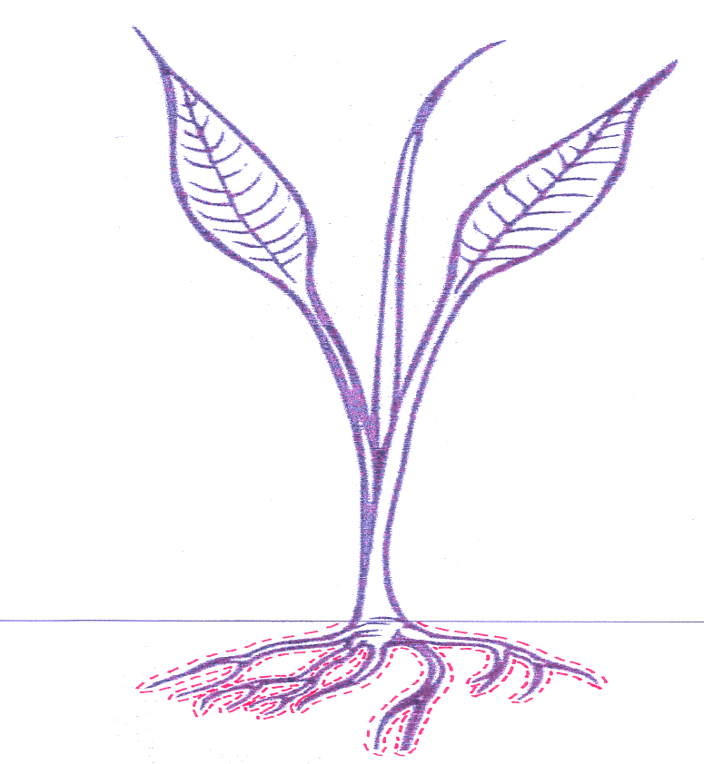
Bray’s Mobility Concept
Mobile Nutrients
Immobile Nutrients
Indicators:
Biomass (% coverage)
Color (concentration)
Indicators:
Biomass (% coverage)
Color (concentration
Nutrient Uptake:
Dependent on growth stage
Dependent on environment
Response depends on reservoir
Nutrient Uptake:
Independent of growth stage
Independent of environment
Response does not depend on reservoir
Root System Sorption Zone
Root Surface Sorption Zone
Sufficiency cannot be used for mobile nutrients due to the fact that a soil test indicates the total amount available within the profile, not within the root system sorption zone.
Sufficiency can be used for immobile nutrients because roots expand within the profile, therefore, the same amount will be available as immobile nutrients are taken up via contact exchange.
Adapted from Raun by Tracy Wilson and Alex Cumbie, 2012

Slide 2
Bray’s Mobility Concept
Mobile Nutrients
Immobile Nutrients
Indicators:
Biomass
Color
Concentration
Indicators:
Biomass
Color
Nutrient Uptake:
Dependent on growth stage
Dependent on environment
Response depends on reservoir
Nutrient Uptake:
Independent of growth stage
Independent of environment
Response does not depend on reservoir
Root System Sorption Zone
Root Surface Sorption Zone
Sufficiency cannot be used for mobile nutrients due to the fact that a soil test indicates the total amount available within the profile, not within the root system sorption zone.
Sufficiency can be used for immobile nutrients because roots expand within the profile, therefore, the same amount will be available as immobile nutrients are taken up via contact exchange.

