Slide 1
Amino Sugar-N Soil Test
Jacob Bushong
SOIL 5813
Feb. 14, 2014

Slide 2
Nitrogen Soil Test History
“Holy Grail” of soil test methods
Several researchers have attempted
Bremner, Stanford, Keeney
Biological or Chemical Methods
Incubation
Acidic or alkaline oxidation or hydrolysis
Analysis of salt extractions

Slide 3
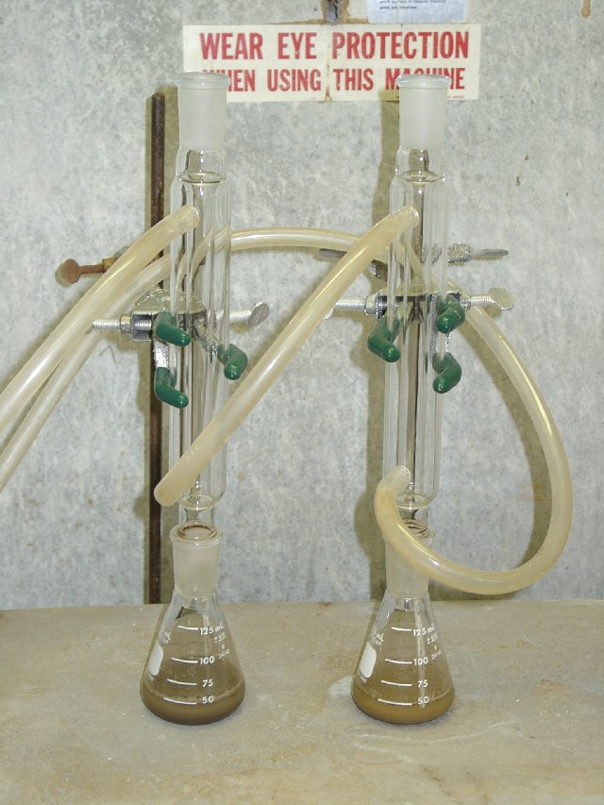
Beginning of the ISNT
Dr. Mulvaney had noticed different responses to sidedress fertilizer applications in corn
Investigated the different organic N forms in soil
Total N
Acid hydrolyzable
NH₄
Amino Sugar
Amino Acid

Slide 4
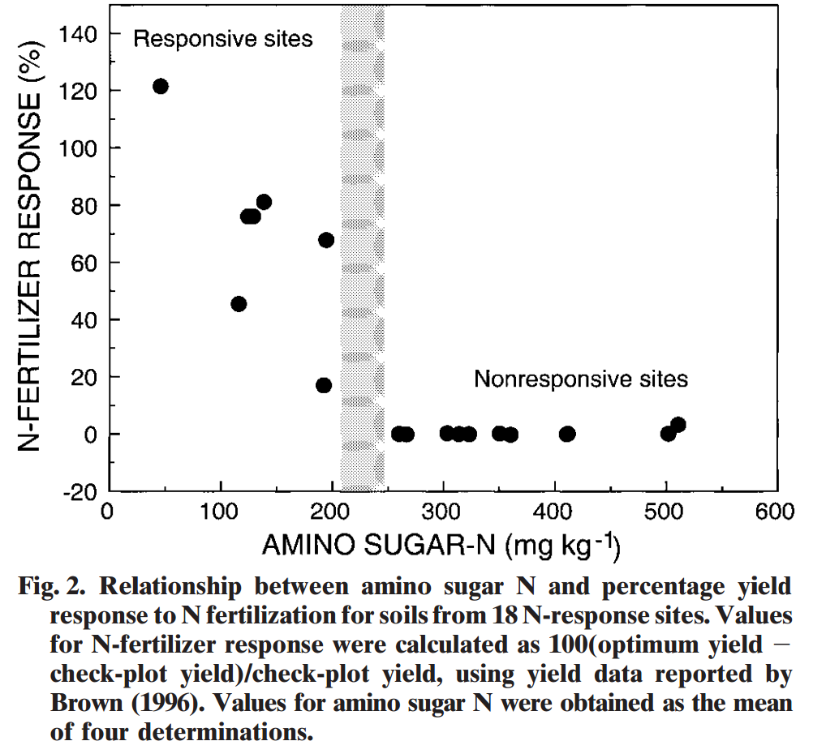
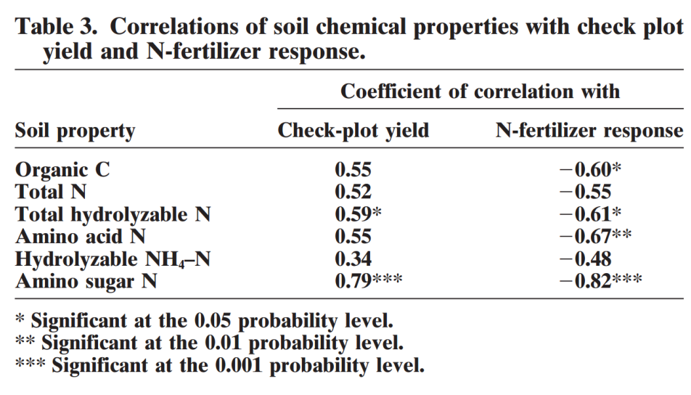
Hydrolyzable Amino Sugar N
Mulvaney et al. (2001)

Slide 5
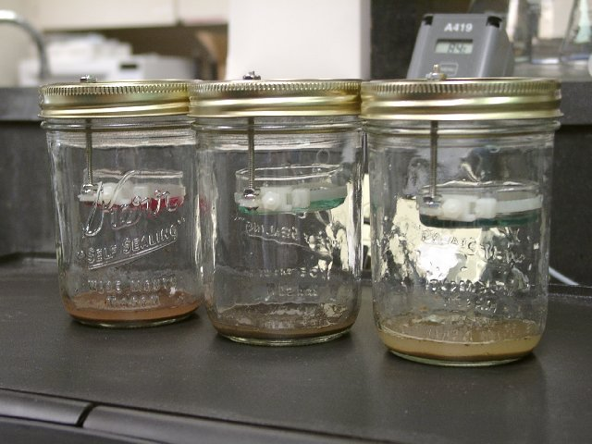
Development of ISNT
Time needed to conduct the hydrolyzable soil test was greater than 12 hours.
Quicker/simpler methods were evaluated
Accelerated Diffusion

Slide 6
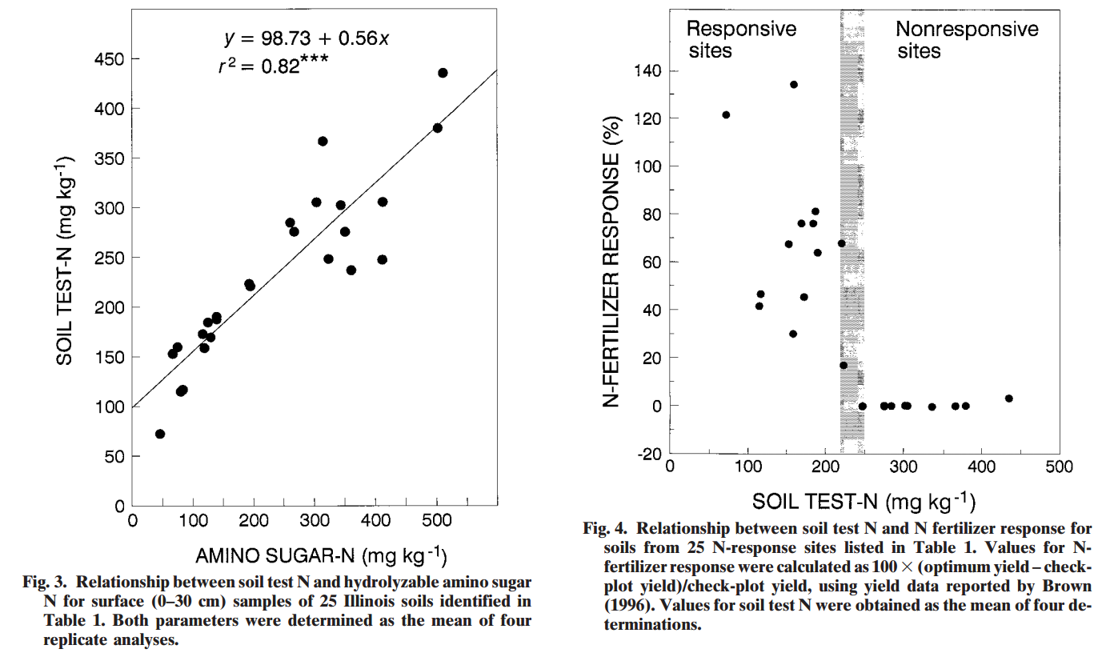
ISNT Results
Khan et al. (2001)

Slide 7
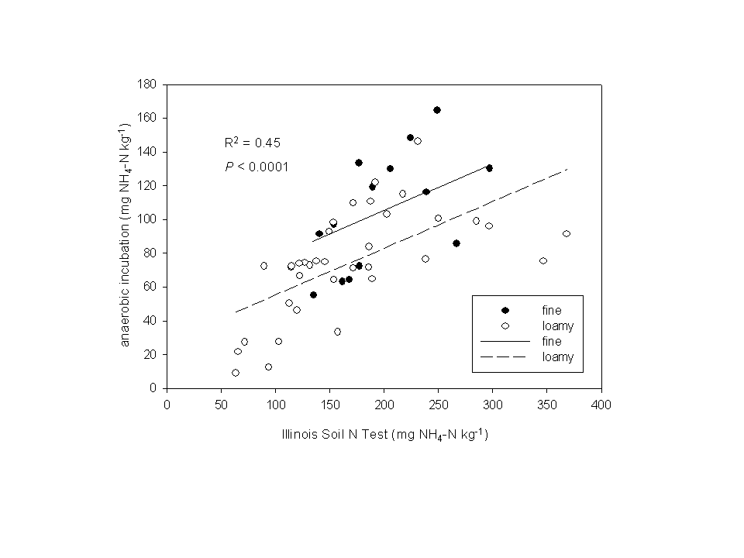
Nitrogen Soil Test for Rice
United States Soils (n = 50)
Arkansas Delta Soils (n = 16)
Bushong et al. (2007)

Slide 8
Evaluation of Hydrolyzable Amino Sugar-N
Bushong et al. (2008)

Slide 9
Evaluation of Hydrolyzable Amino Sugar-N
6 Hours
10 Minutes
Bushong et al. (2008)

Slide 10
Evaluation of Hydrolyzable Amino Sugar-N
N-ST*R
Bushong et al. (2008)

Slide 11
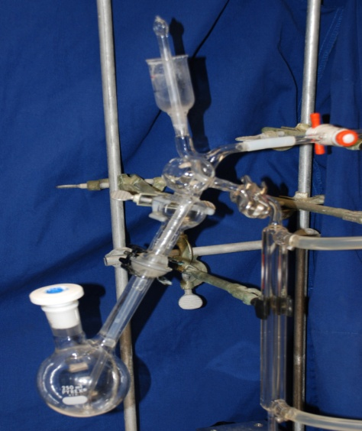
Field Evaluation of N-ST*R
Roberts et al. (2011)

Slide 12
Other’s Results for Corn
Laboski et al. (2008)

