Slide 1
Phosphorus USE Efficiency
Oklahoma State University, Stillwater, OK

Slide 2
Methods
YP (uptake, P treated plot)
YO (uptake, no P applied)
FP (fertilizer P rate)
direct method (³²P, proportion of added nutrient recovered in the crop)
rarely more than 25% difference method (YP-YO)/FP (apparent recovery or apparent efficiency) partial factor productivity index (kg product /kg nutrient applied, or YP/FP) physiological efficiency index
(kg product increase/ kg increase in nutrient taken up (YP- YO)/(UP - UO). (YP, YO, UP and UO as above) balance method
total P in the crop / P applied (UP/FP)

Slide 5
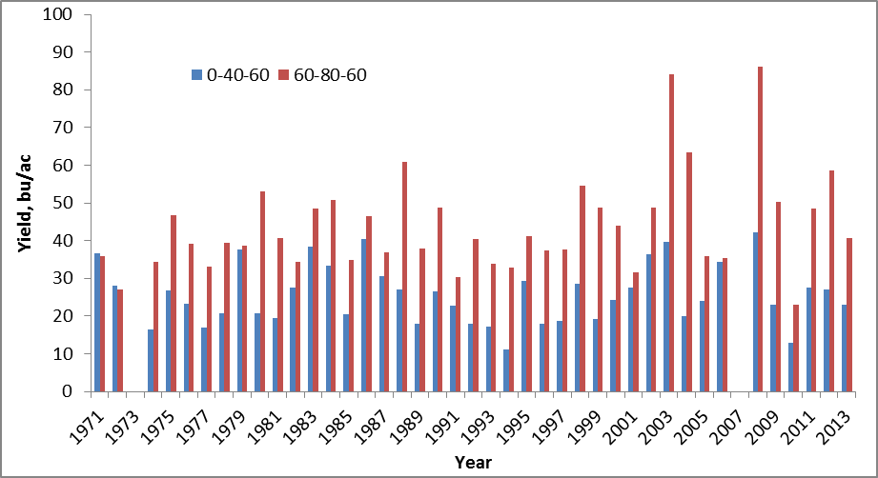
New 1

Slide 6
New 2

Slide 7
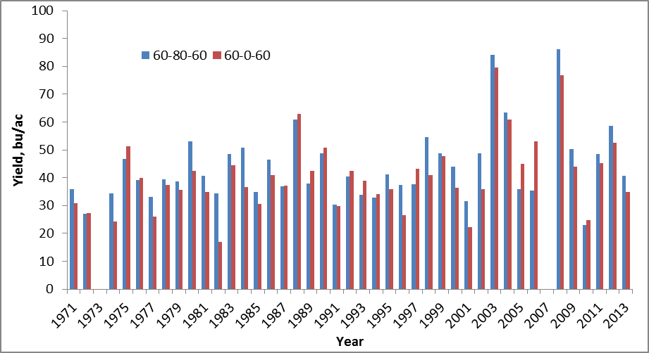
New 3

Slide 8
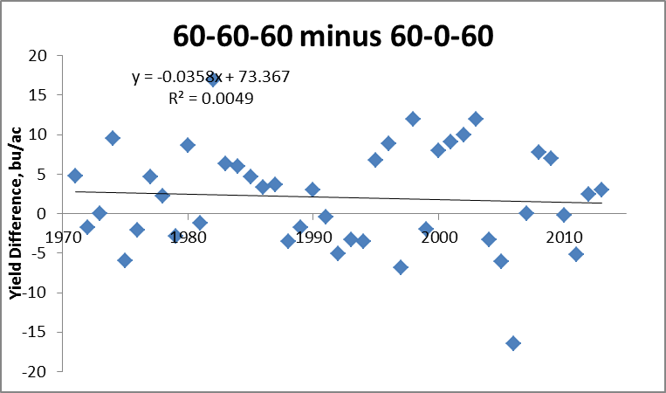

Slide 9
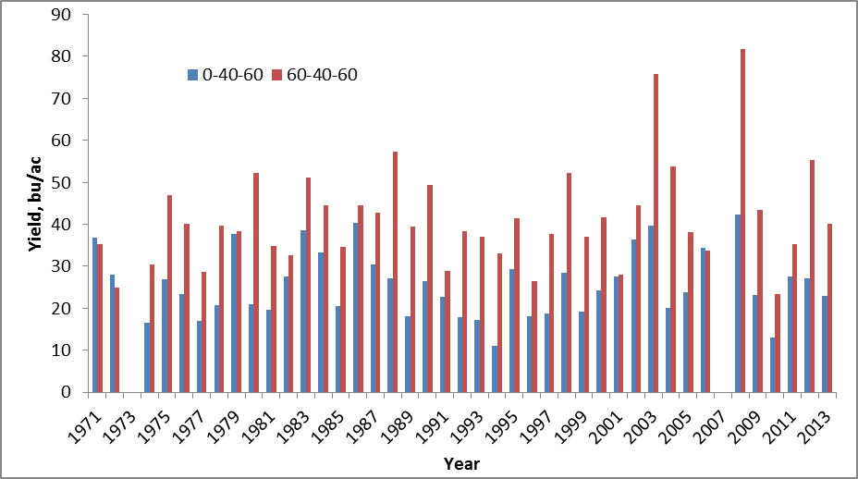
N Response, same P and K (502)

Slide 10
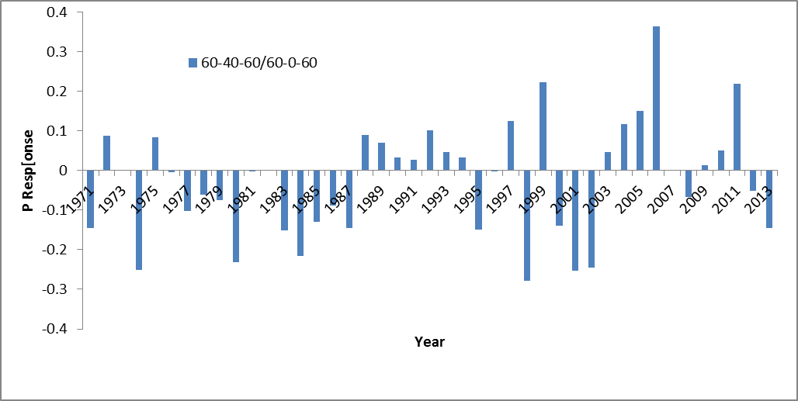
502 60-40-60 / 60-0-60

Slide 11
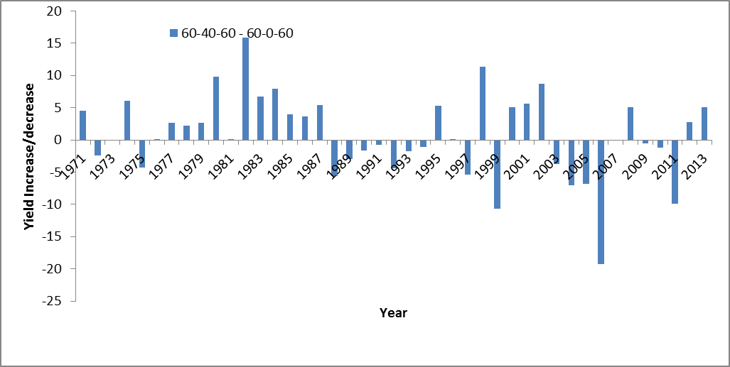
502 Yield Increase/Decrease 60-40-60 - 60-0-60

Slide 12
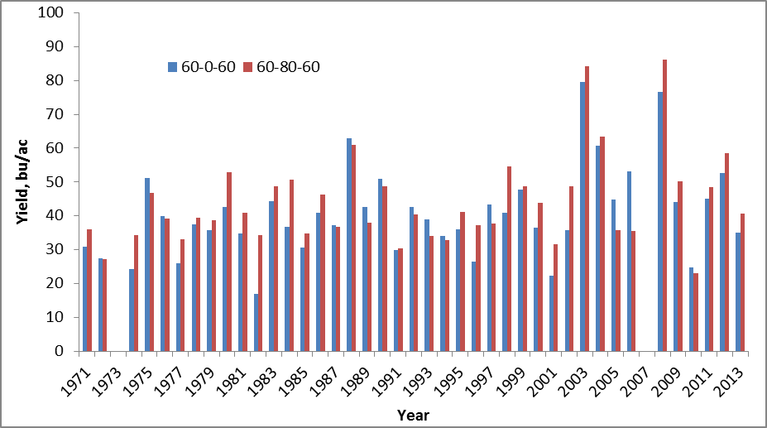
502, P Response

Slide 13
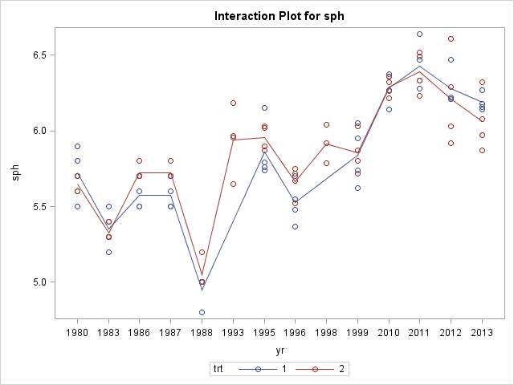
1 ( 0-0-0 ) 2 (0-40-0)

Slide 14
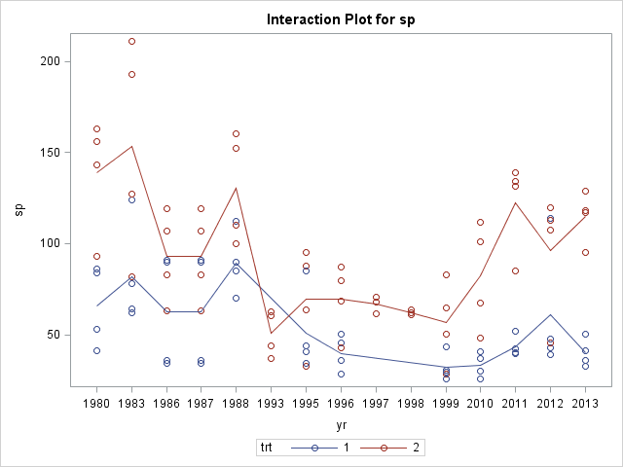
1 ( 0-0-0 ) 2 (0-40-0)

