Slide 1
Global Agricultural and Environmental Issues

Slide 2
“The human mind, when stretched by a new idea, can never shrink to its original size” Oliver Wendell Holmes

Slide 3
“Leadership is a quality of people that when other people observe their actions, they gain confidence in their own actions” Tom Landry

Slide 4
“What I like about the American people is that they always do what is right — after they have tried everything else” Winston Churchill

Slide 5
We cannot talk about agriculture without talking about the environment; we cannot talk about the environment with talking about agriculture; and we cannot talk about either without talking about the entire world. They are inextricably linked.

Slide 6
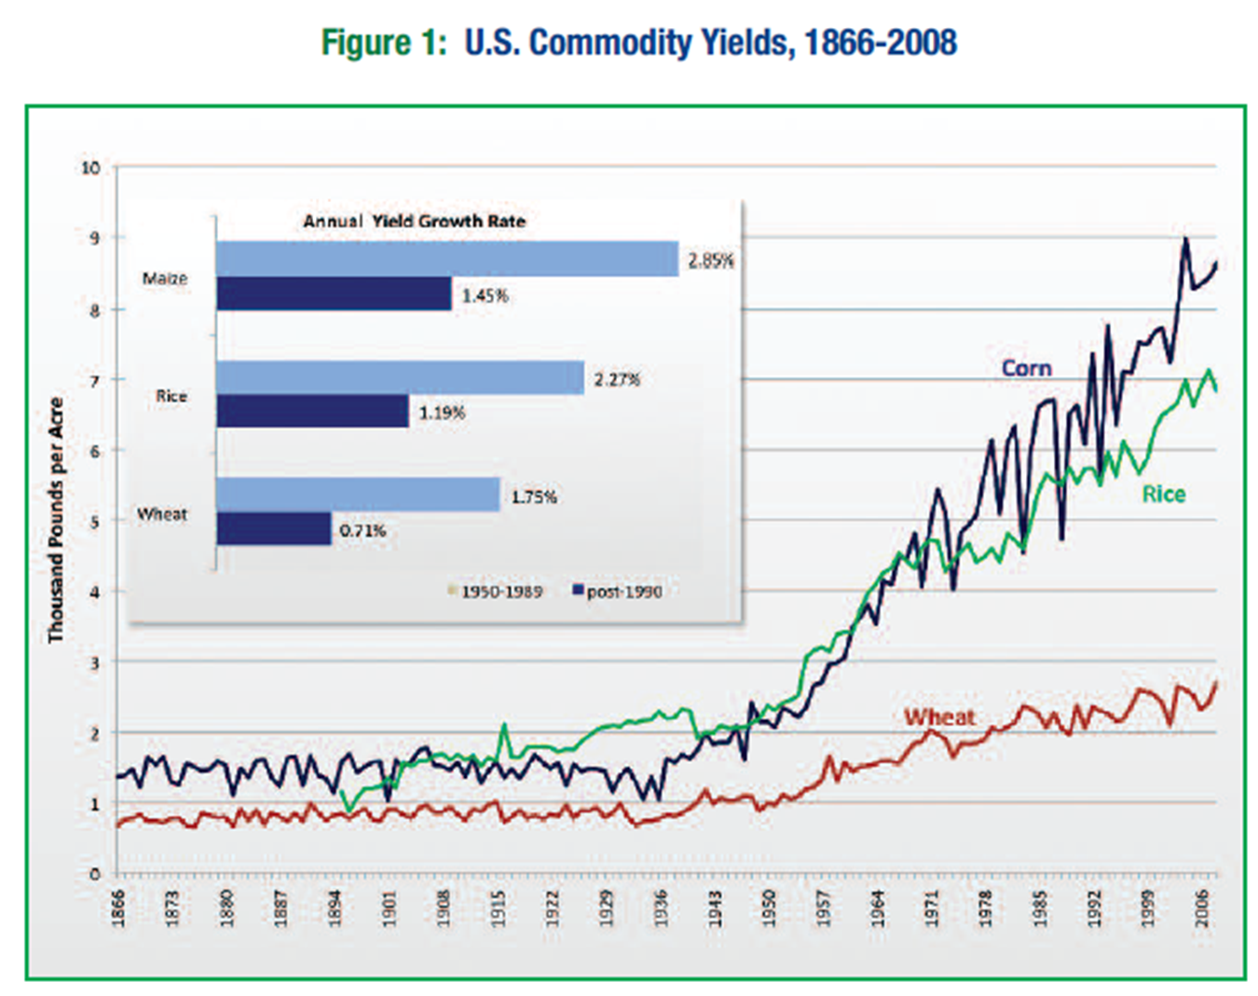
World War II ended 1945
Oklahoma State
University established 1890
Farm Foundation Issue Report September 2009

Slide 7
Projections are by 2050 there will be 9.1 billion people. This is an increase of about 30%, but it is estimated that food production during the same period will have to increase 70%. Approximately 95% of the increased population will be in developing countries.

Slide 8
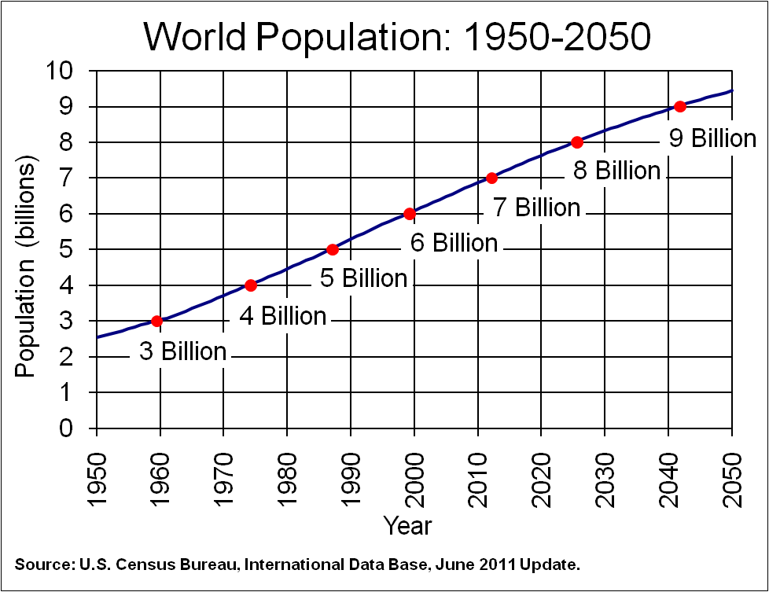
Today

Slide 9
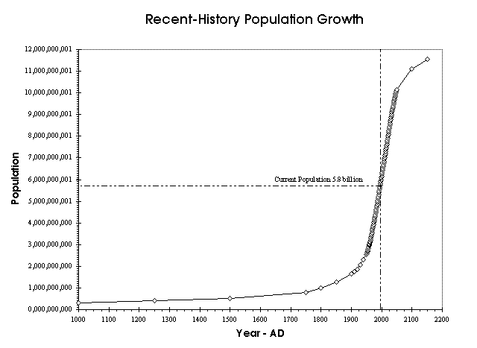
Career of New Graduates
Time of My Career

Slide 10
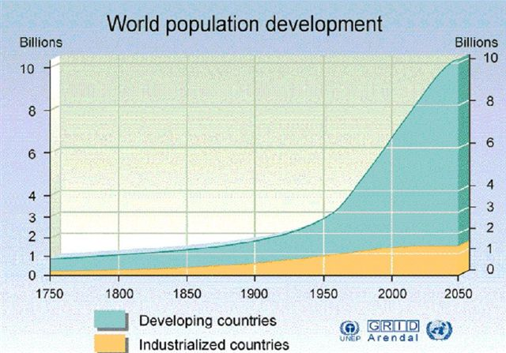
Essentially all of the increase by 2050
will be in developing countries

Slide 11
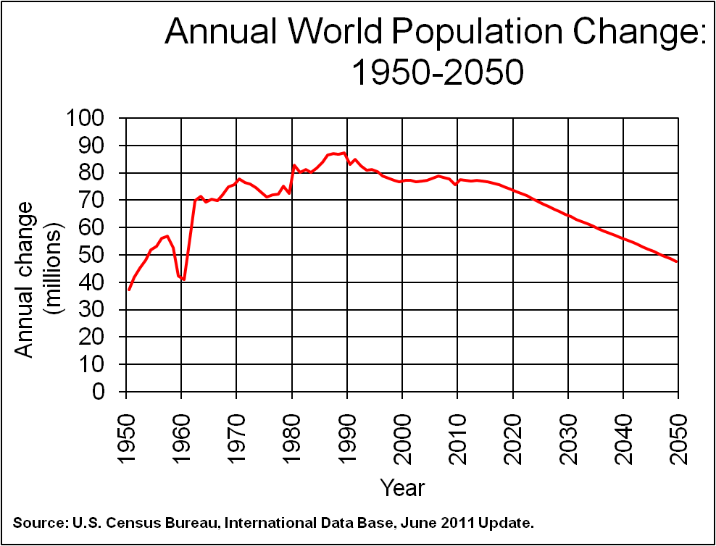

Slide 12
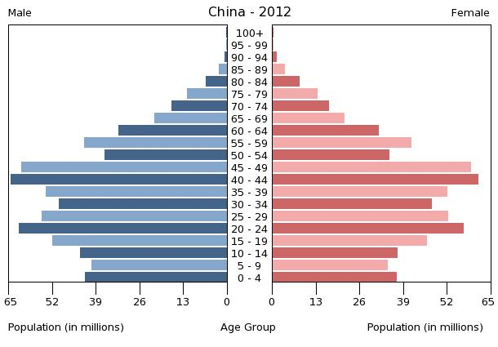
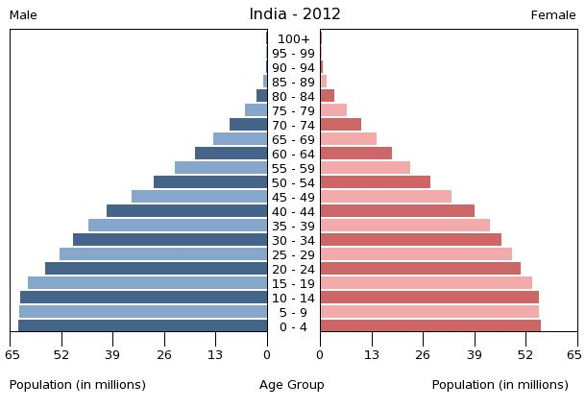
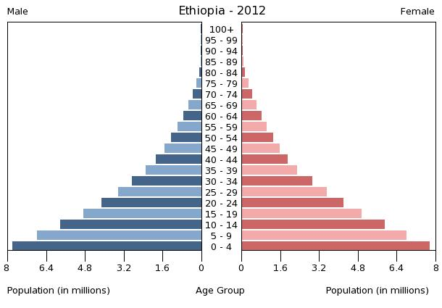
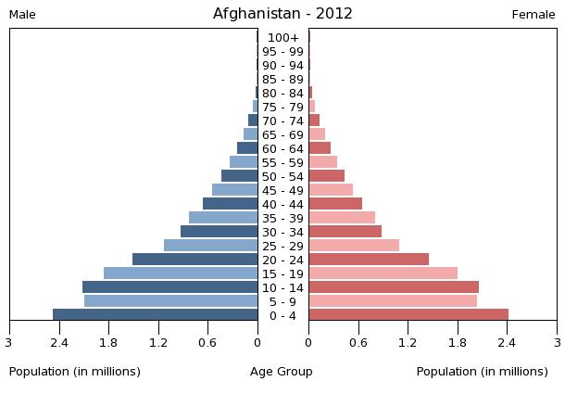

Slide 13
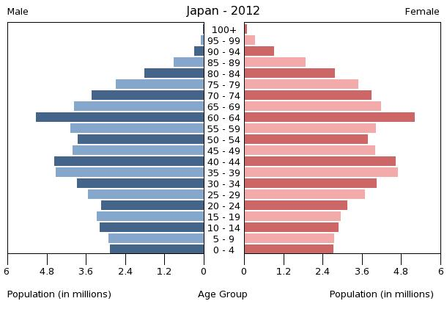
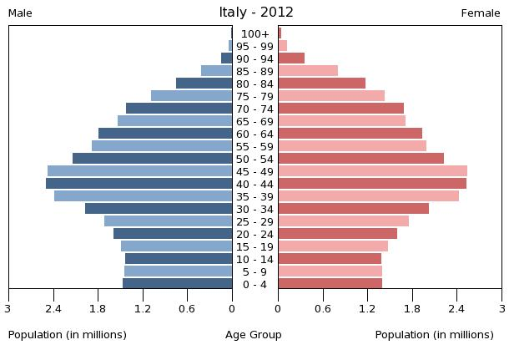
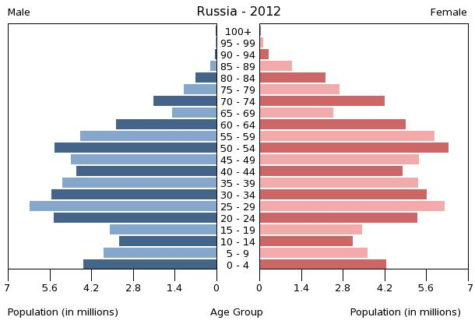
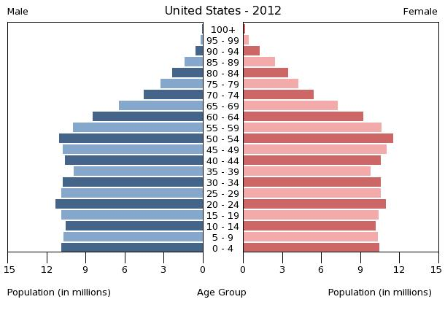

Slide 15
Grain production is vital because worldwide people get 48% of their calories from eating grain directly. As incomes rise, the percent drops dramatically as diets change to include more meat, milk, eggs and other foods that require more grain to produce. About 48% of grains are eaten directly, 35% fed to animals, and 17% for ethanol and other fuels.
(Worldwatch Institute, August 12, 2011 http://worldwatch.org/node/5539)

Slide 16
At the top of the food chain rankings, people in U.S. and Canada consume about 800 kg annually, mostly as meat, milk and eggs. At the bottom, India consumes about 200 kg consuming nearly all directly, leaving little for conversion to protein. The world average production of grain per person is about 350 kg per person compared to 285 in 1961.
(Food and Agriculture Organization Statistics, Rome)

Slide 17
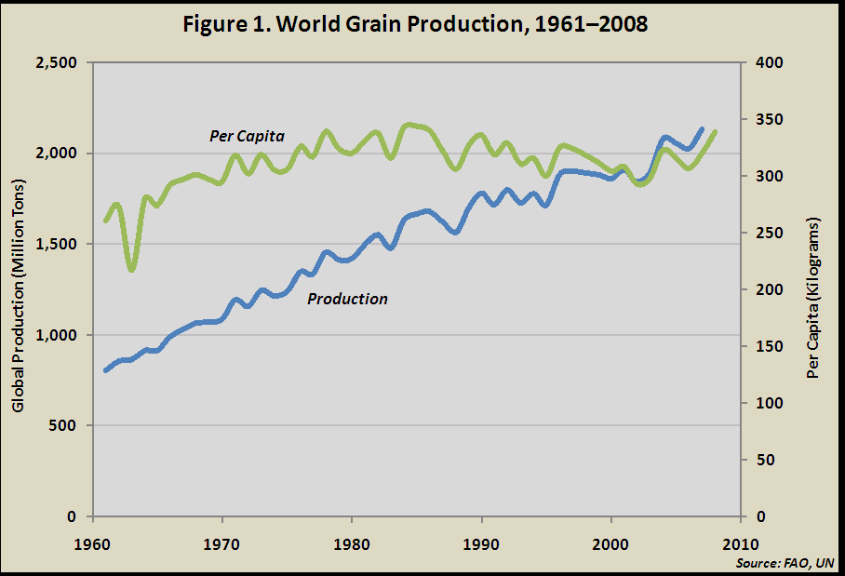

Slide 18
 | 1961 | 1970 | 1980 | 1990 | 2000 | 2010
 | ------------------------Million tonnes--------------------------
Wheat | 222 | 310 | 440 | 592 | 586 | 654
Rice | 216 | 316 | 397 | 519 | 599 | 696
Corn | 205 | 266 | 397 | 483 | 592 | 840

Slide 19
 | 1961 | 1970 | 1980 | 1990 | 2000 | 2009
Cropland (Million ha) | 1282 | 1330 | 1352 | 1404 | 1385 | 1381
Irrigated land (Million ha) | 139 | 168 | 210 | 244 | 277 | 280
% Cropland Irrigated | 10.8 | 12.9 | 15.8 | 17.7 | 20.0 | 20.3
N fertilizer (Million t) | 11.6 | 31.8 | 60.8 | 77.2 | 80.8 | 105.1
Phosphate (Million t) | 10.9 | 21.1 | 31.7 | 36.0 | 32.4 | 39.2
Source: Food and Agriculture Organization, Rome

Slide 20
Of the 7 billion people in the World, more than 1 billion live on less than $1 per day.
More than 2.7 billion live on less than $2 per day.
The World Bank has estimated that the number of people in developing countries with household incomes of $16,000 will increase from 352 million in 2000 to 2.1 billion by 2030.
The most important determinant for global food demand will depend on how many low income consumers are lifted out of poverty.

Slide 21
Calories/person: FAO minimum requirement 2500
 | 1961 | 1970 | 1980 | 1990 | 2000 | 2009
China
Total | 1426 | 1858 | 2163 | 2562 | 2867 | 3036
Animal | 56 | 114 | 174 | 307 | 562 | 694
India
Total | 2017 | 2116 | 1990 | 2185 | 2264 | 2321
Animal | 112 | 101 | 116 | 157 | 180 | 209
Africa
Total | 1997 | 2109 | 2221 | 2278 | 2421 | 2560
Animal | 160 | 172 | 192 | 184 | 185 | 207

Slide 22
Calories/person: FAO minimum requirement 2500
 | 1961 | 1970 | 1980 | 1990 | 2000 | 2009
Japan
Total | 2524 | 2743 | 2795 | 2945 | 2902 | 2723
Animal | 249 | 428 | 537 | 616 | 609 | 566
Ethiopia
Total |  |  |  |  | 1808 | 2097
Animal |  |  |  |  | 81 | 97
U.S.
Total | 2851 | 3035 | 3183 | 3507 | 3804 | 3688
Animal | 1010 | 982 | 966 | 975 | 1033 | 1013

Slide 23
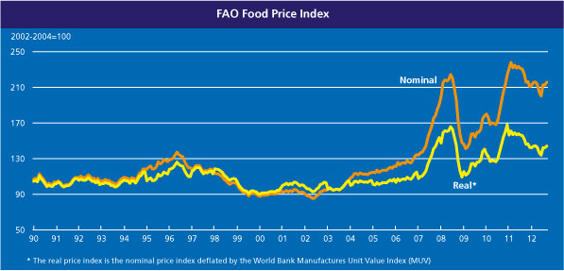
U.S. 6.9% 3770 calories Ethiopia 57% 1950 calories
Ireland 8.5% 3530 cal. Bolivia 61% 2090 cal.
France 13.8% 3550 cal. Angola 80% 1950 cal.
Italy 14.7% 3550 cal.
Twenty poorest countries spend more than 50% of income on food.

Slide 24
Americans Eat the Cheapest Food in the World,
But What is It Really Costing Us?
USDA data shows that in 2010 Americans spent 9.4 percent of their disposable income on food, which equals 5.5 percent at home and 3.9 percent eating out. As a nation, we spend far less of a percentage on our food than we ever have before. For example, in 1929 we spent 23.4 percent of our disposable income on food, which equaled 20.3 percent at home and 3.1 percent eating out.

Slide 25
Land Resources

Slide 26
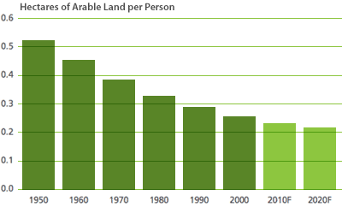
1.25 acre
0.5 acre
Australia 6 ac./p United States 1.5 ac./p
China 0.2 ac./p Japan 0.1 ac./p

Slide 27
There currently remains some 2.7 billion hectares of land with potential for crop production in the world, concentrated in South and Central American and Sub-Saharan Africa. This is about 20% of current use.
(Source: Future Directions International)

Slide 28
Water Resources

Slide 29
Worldwide, 70% of all the water used from rivers and lakes, or pumped from aquifers is used for irrigation, 20% for industry, and 10% for residential purposes. With water demand increasing in all sectors, competition is intensifying and agriculture almost always lose to cities and industries. Agriculture must improve irrigation efficiency.

Slide 30
Irrigation is expanding at a slower rate. Area per capita is decreasing.

Slide 31
Energy Resources

Slide 32
Following World War II, agriculture was developed with cheap energy. Between 1950 and 1980, agricultural production doubled. This increase was largely due to energy inputs. Between 1950 and 1985, tractor fleet quadrupled, irrigated area tripled, fertilizer use increased nine-fold. Total energy use increased 6.9 times.

Slide 33
Since 1900 the world’s cultivated area increased by about one-third, but because of a more than fourfold increase in productivity, total production has increased almost sixfold. A major portion of this gain can be attributed to selective breeding programs and to an eightyfold increase in external energy inputs, mostly in the form of fossil fuels. (Jason Clay, 2004).

Slide 34
Bushels wheat required to buy barrel of oil
OPEC was formed

Slide 35
China’s use doubled between 2000 and 2010
Canada and U.S. 5% of people; India and China 36% and their economies growing 8 to 10% per year.

Slide 36
Nutrients

Slide 37
With cheap energy, the world started “experimenting” with the chemistry of the environment, and the results have raised far more questions than answers, and agriculture is in the eye of the storm. The Haber-Bosch process uses energy to convert N₂ that makes up 80% of the air into NH₃ that can be used by plants. This revolutionized agriculture.

Slide 38
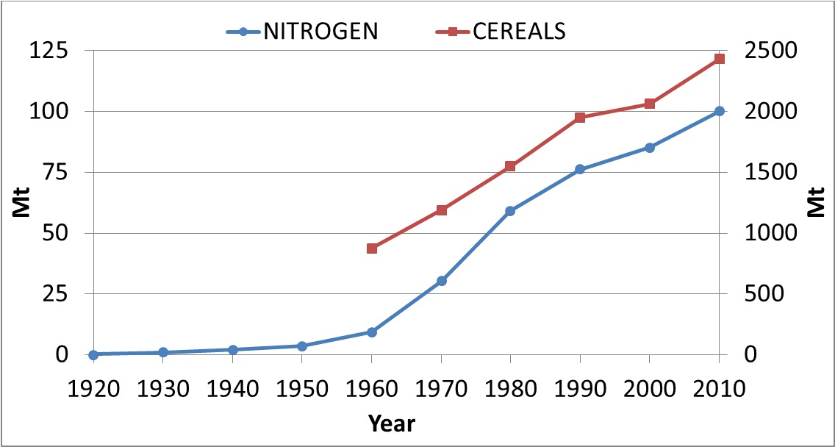
Worldwide use of N fertilizer and cereal production
World War II ended and plants used to make N for bombs were converted to Fertilizer plants
Assuming 10% protein, less than 40 Mt of N are removed annually by all the grains produced in the world.

Slide 39
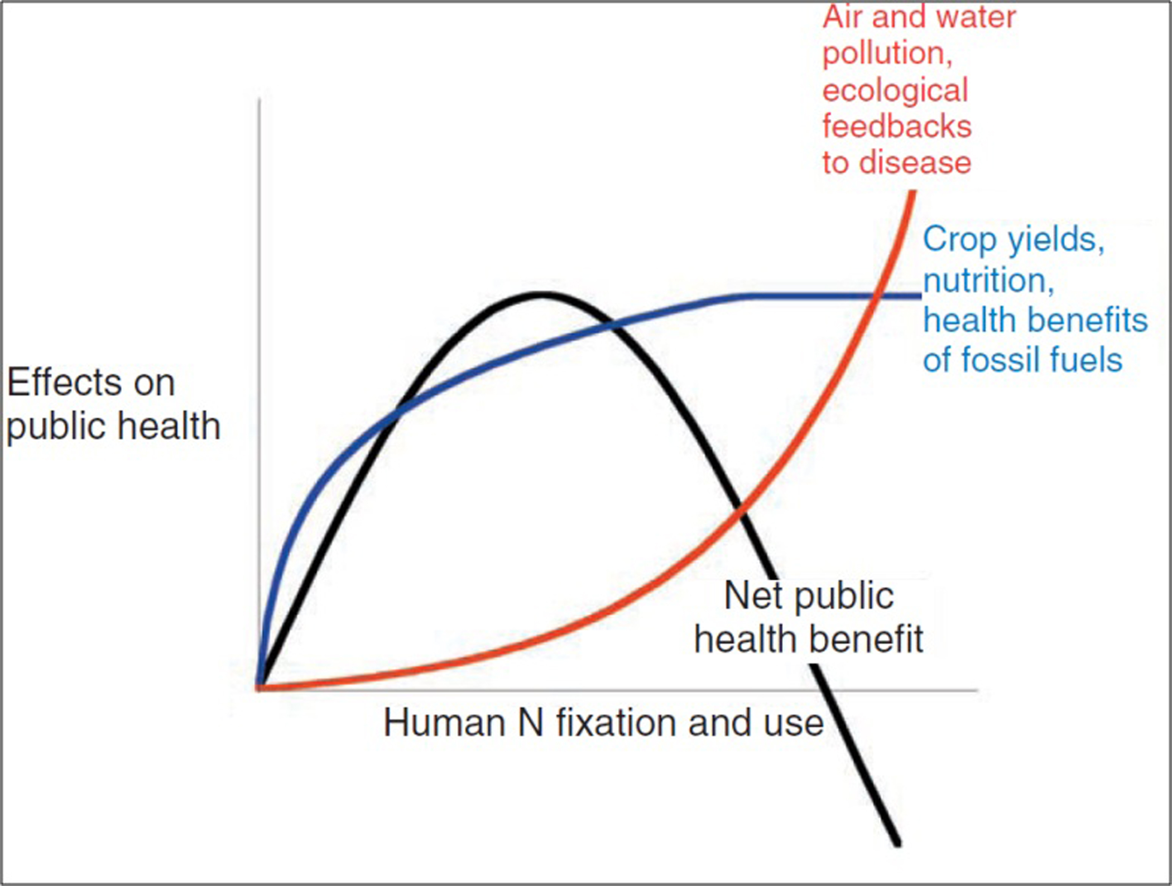
Townsend et al. 2003 Ecol. Environ. 1:240-248

Slide 40
The U.S. uses more than 10 million tons of fertilizer nitrogen and about 4 million tons of P₂O₅ each year. The N comes from the air, and the P comes from mines. Much of the fertilizer is used for growing corn and soybeans, a lot of which is moved to animal growing areas.

Slide 41
This process is repeated year after year so tremendous amounts of N and P are ADDED to the environment every year. Where are these nutrients going and how are they affecting the “chemistry of the environment?” This is one of the “experiments” we are conducting.

Slide 42
Every action has a reaction, and there are consequences. Some are short-term, some are long-term, some are positive, but some are negative. My generation focused mostly on the short term and positive results. Your generation MUST be concerned with the long-term and consider the negative as well as the positive. You must think SYSTEMS, not wheat fields.

Slide 43
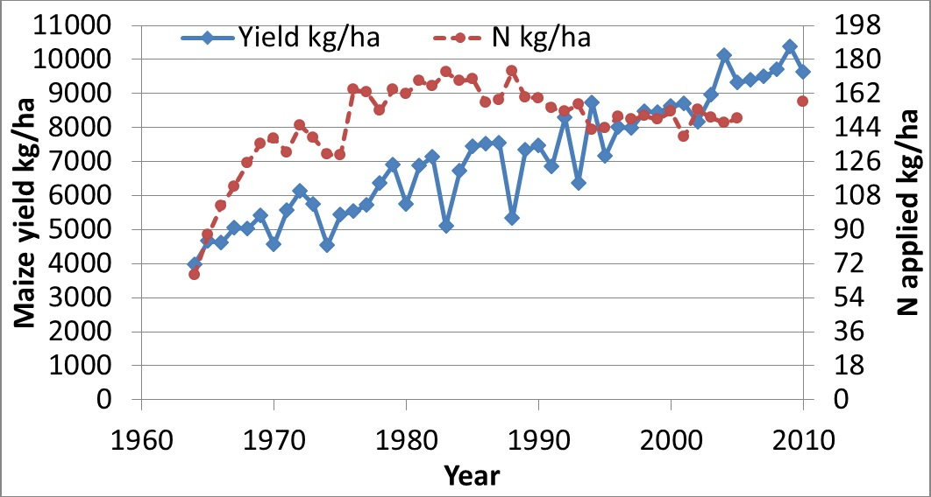
Source: USDA National Agricultural Statistics Service
Rachel Carson wrote “Silent Spring” in 1962. April 22, 1970, first Earth Day in U.S., when 20 million Americans took to the streets, is often cited as start of environmental movement. Environmental Protection Agency (EPA) was established in 1970.

Slide 44
Nutrients in grain from cropland areas are moved to animal feeding areas where most of the nutrients end up in manure and results in an excess of nutrients, particularly N and P, in areas where they are not needed. Then, more N is taken from the air, and more P from the mines, and the process begins again.

Slide 45
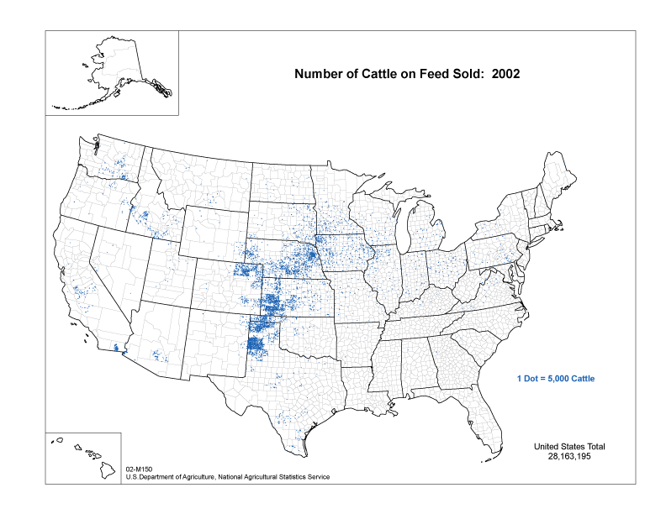

Slide 46
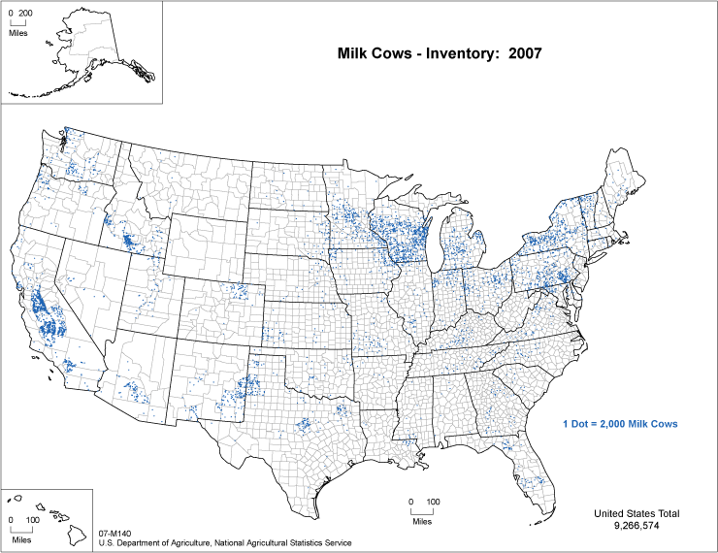

Slide 47
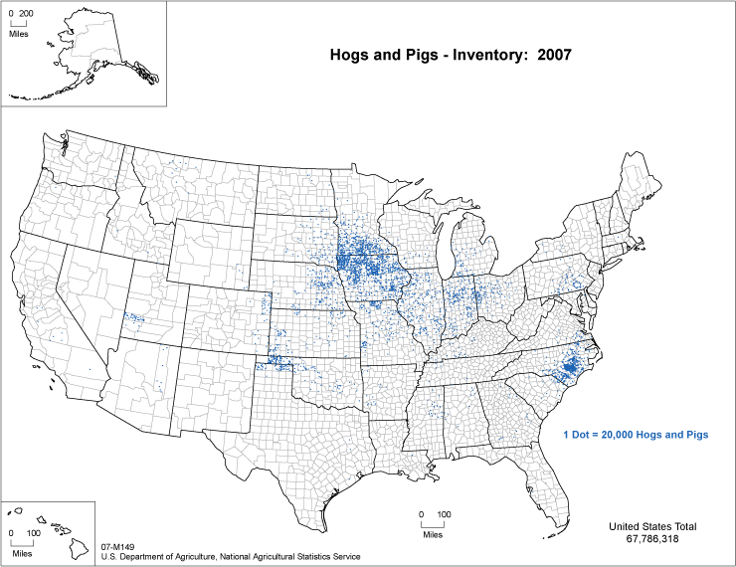

Slide 48
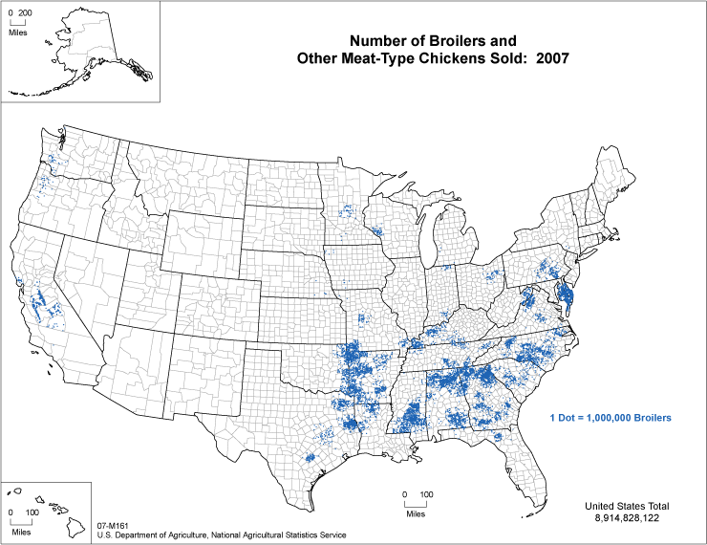

Slide 49
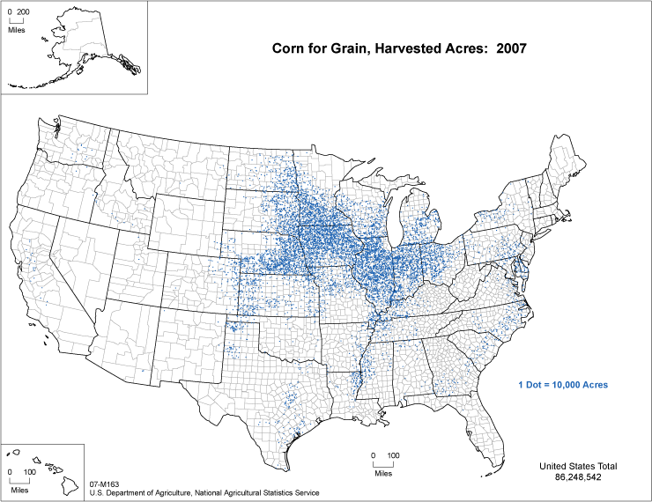

Slide 50
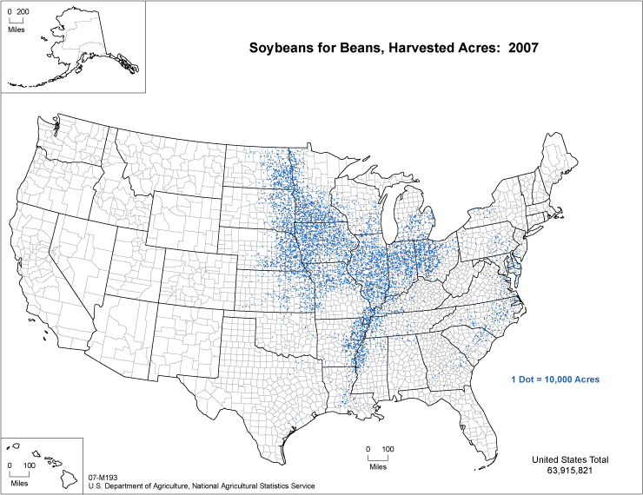

Slide 51
The next several figures are going to show the trends of P in manure compared to P removed by crops for all counties in the 48 contiguous states.

Slide 52
Legends for P Maps
Less than 25% P taken up and removed by crops (or applied to pasture) could be supplied from manure (WHITE)
25 to 50% (LIGHT TAN)
50 to 100% (DARK BROWN)
Greater than 100% (BLUE)

Slide 53
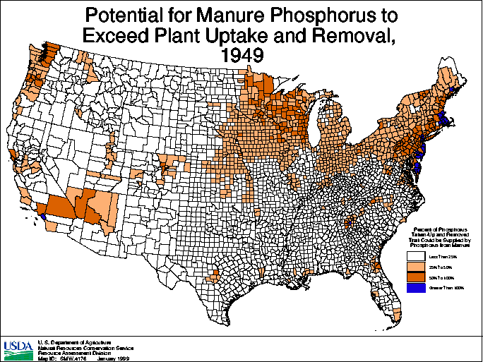

Slide 54
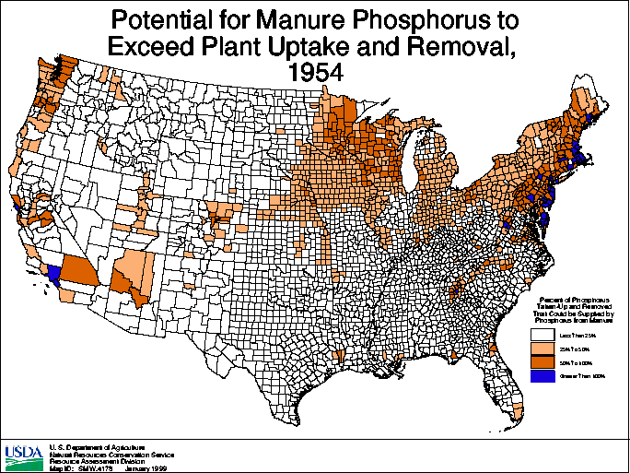

Slide 55
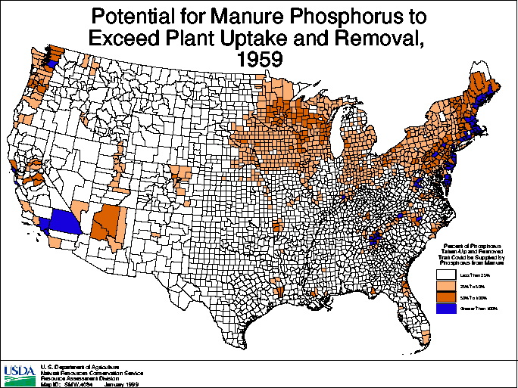

Slide 56
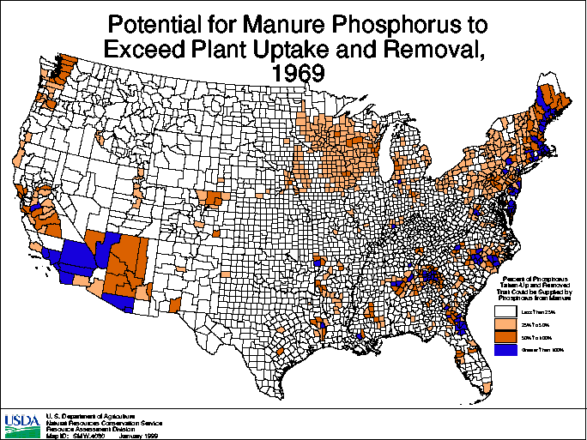

Slide 57
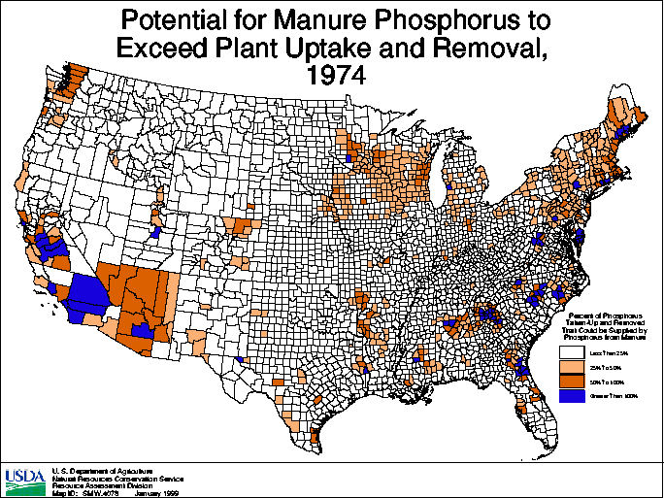

Slide 58
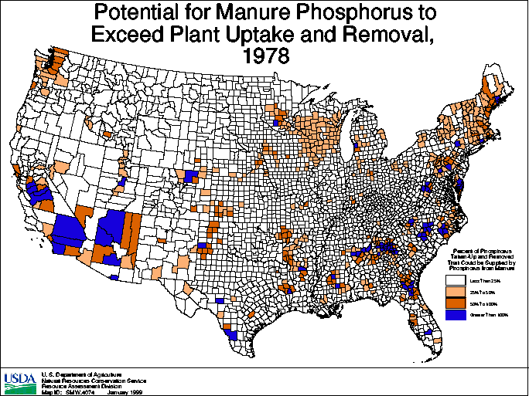

Slide 59
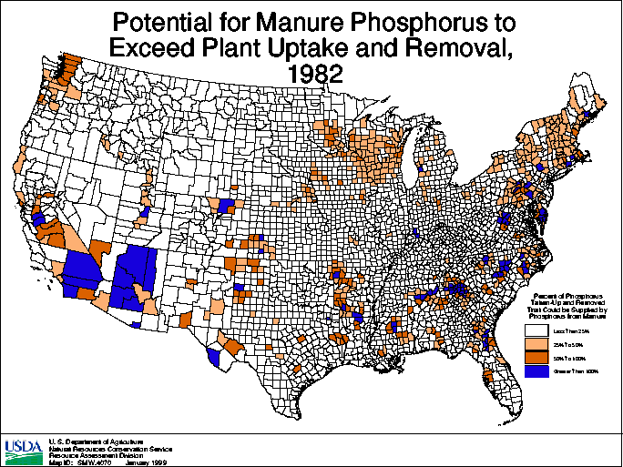

Slide 61
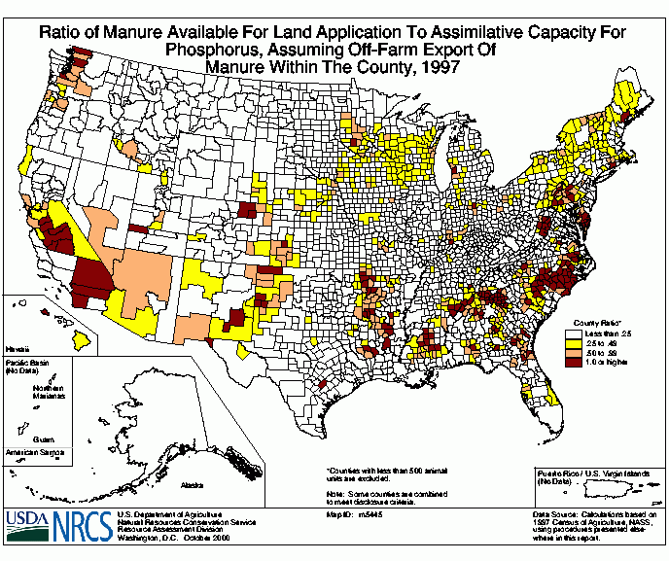

Slide 62
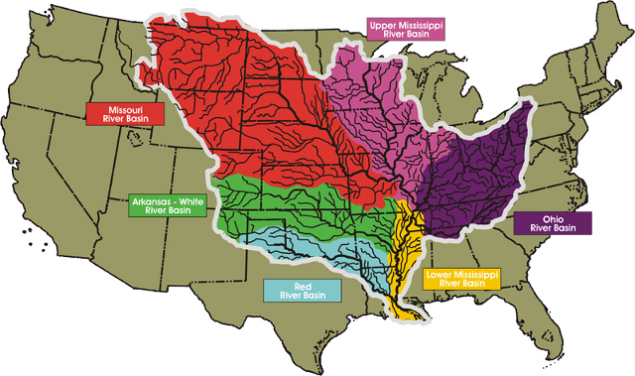
Enrichment of nutrients causing depletion of oxygen.
Hypoxia in the Gulf of Mexico
Source: Louisiana Universities Marine Consortium http://www.gulfhypoxia.net/overview/

Slide 63
Nov. 2, 2012 Des Moines Register releases collection of articles on Gulf Dead Zone
Dead Zone’s size tied to water levels
Years of work fail to cut flow of nitrates in Gulf
Runoff from Iowa farms growing concern in Dead Zone
Farmers motivated to help the cause
Shrimpers fear long-term harm from Dead Zone
Scientists size up area of hypoxia in Gulf of Mexico

Slide 64
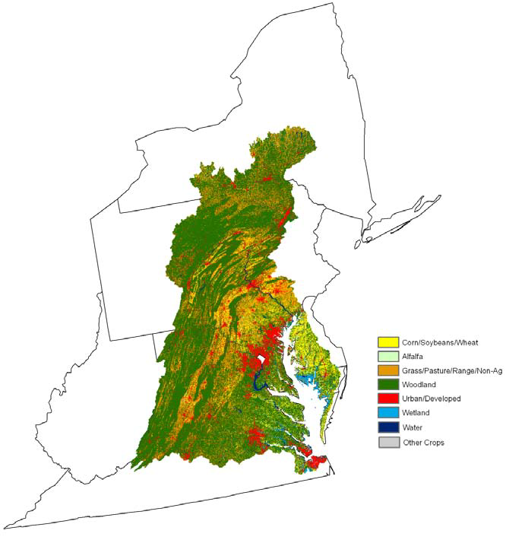
Significant improvement is still needed in nutrient management . About 81 percent of the cultivated cropland acres require additional nutrient management to reduce the loss of nitrogen or phosphorus from fields.
Chesapeake Bay Area
Source: http://www.livablefutureblog.com/wp-content/uploads/2010/10/ceap_chesapeake_bay_report.pdf

Slide 65
More than 35,000 residents of Maryland, Virginia, the District of Columbia and other states have signed a petition calling on the EPA to set strong limits on factory farm pollution to protect waterways across the country.
Source: FrederickNewsPost.com October 13, 2012
http://www.fredericknewspost.com/sections/business/display.htm?StoryID=141916#.UH61KK549Eg

Slide 66
In short, we are moving phosphorus from mines to the oceans. Not only from agricultural practices, but as world population becomes more concentrated in cities, more of the phosphorus from human wastes end up in effluents that eventually move to the oceans. Historically, much of this was recycled to the land.

Slide 67
Thinking long-term, N and P are the two most important plant nutrients. N is unlimited since it can be obtained from the air, but no matter how much phosphate rock exists, it is a non-renewable resource. Current estimates are that there is a 300 to 400 year known supply, but it is concentrated within a few countries.

Slide 68
Global Warming

Slide 69
Global warming is “unequivocal.” The only question is whether or not this is just a natural cycle and it will reverse itself in time, or whether you and I are causing it. This is not an easy question to answer with science, particularly in the short term, and an even more difficult question to answer socially and economically. Agriculture has a lot at stake, however, because if society determines it is Man-Made, agriculture will be looked on as a major contributor to the problem, but also as a major force for alleviating the problem.

Slide 70
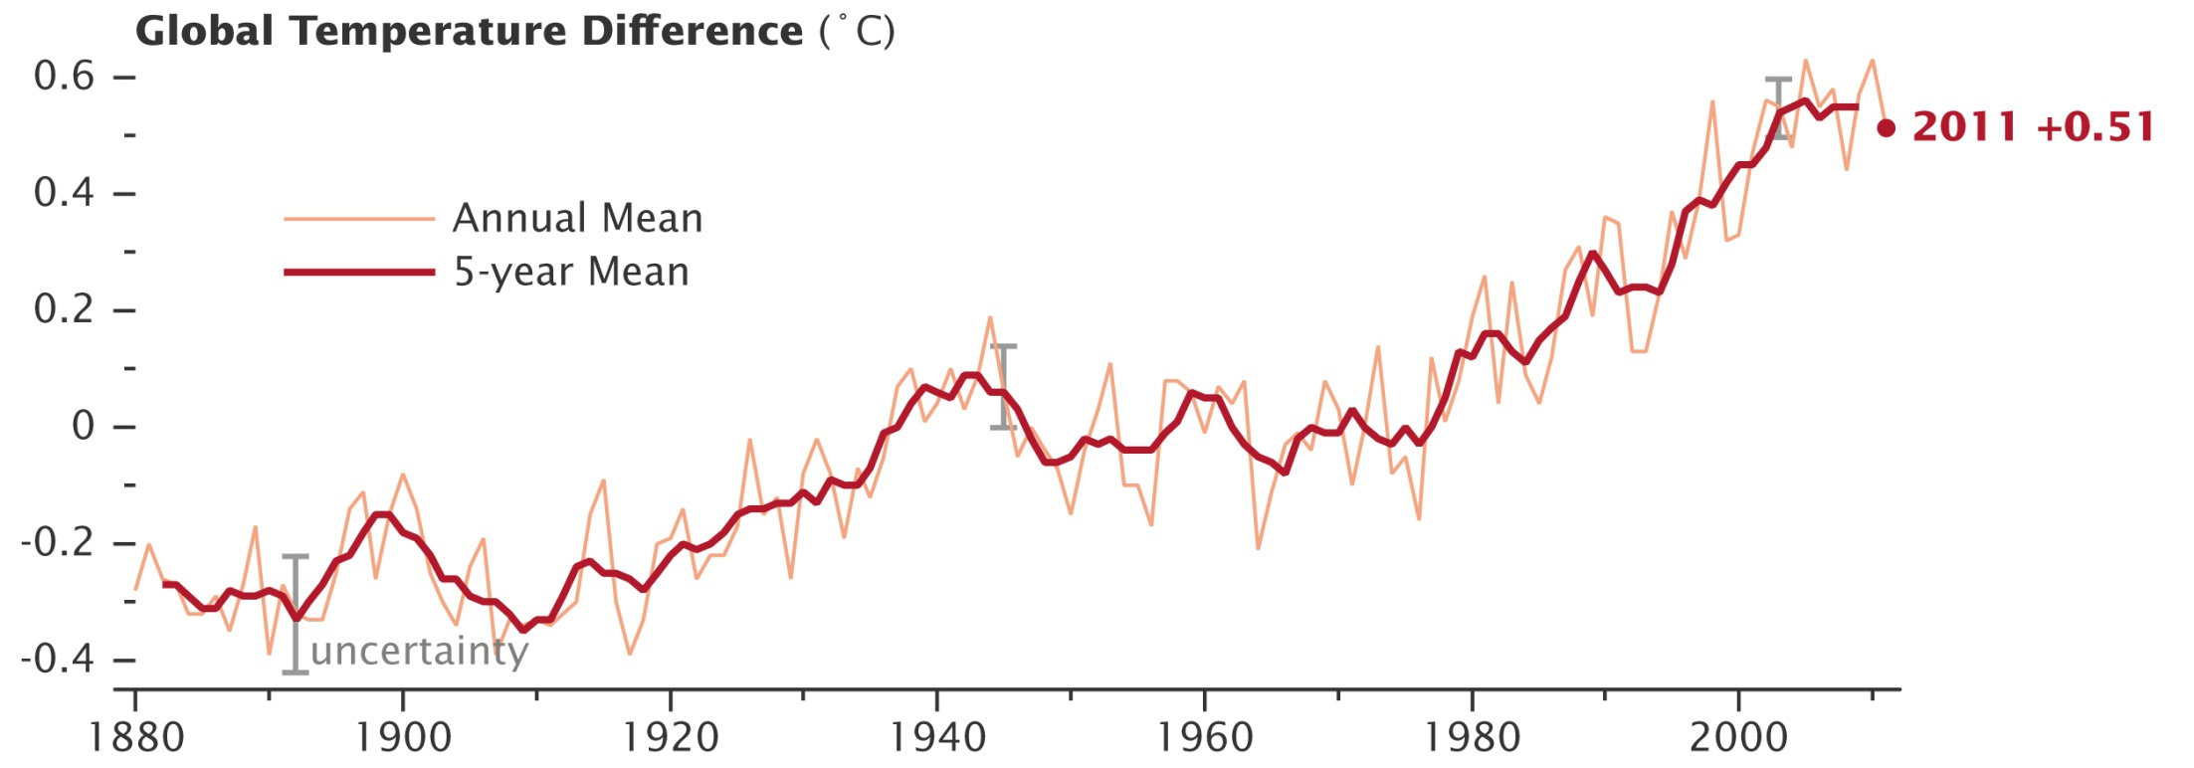
While average global temperature will still fluctuate from year to year, scientists focus on the decadal trend. Nine of the 10 warmest years since 1880 have occurred since the year 2000, as the Earth has experienced sustained higher temperatures than in any decade during the 20th century. As greenhouse gas emissions and atmospheric carbon dioxide levels continue to rise, scientists expect the long-term temperature increase to continue as well. (Data source: NASA Goddard Institute for Space Studies. Image credit: NASA Earth Observatory, Robert Simmon)
While average global temperature will still fluctuate from year to year, scientists focus on the decadal trend. Nine of the 10 warmest years since 1880 have occurred since the year 2000, as the Earth has experienced sustained higher temperatures than in any decade during the 20th century. As greenhouse gas emissions and atmospheric carbon dioxide levels continue to rise, scientists expect the long-term temperature increase to continue as well. (Data source: NASA Goddard Institute for Space Studies. Image credit: NASA Earth Observatory, Robert Simmon)
Through 2011, 9 of the 10 warmest years since 1880 have occurred since the year 2000, and 2012 is expected to be the hottest ever recorded.
(NASA Goddard Institute for Space Studies)

Slide 71
Within the last few years, crop ecologists in several countries have been focusing on the precise relationship between temperature and crop yields. A comprehensive study by eminent crop scientists at the International Rice Research Institute (IRRI) has confirmed the “rule of thumb” emerging among crop scientists that a 1°C (1.8°F) rise in temperature above the norm levels lowers wheat, rice, and corn yields by 10 percent. Unless this increase in global temperature is temporary, this will make it increasingly difficult to feed the Earth’s growing and more prosperous population.

Slide 72
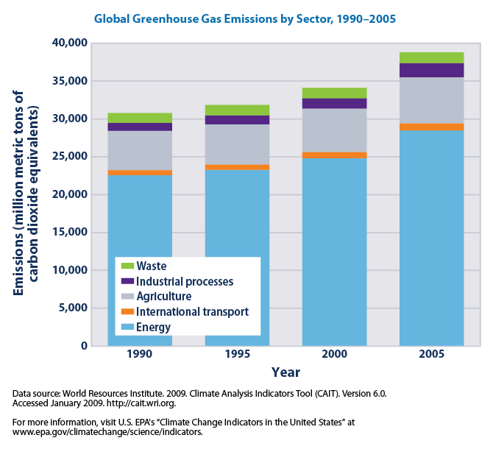

Slide 73
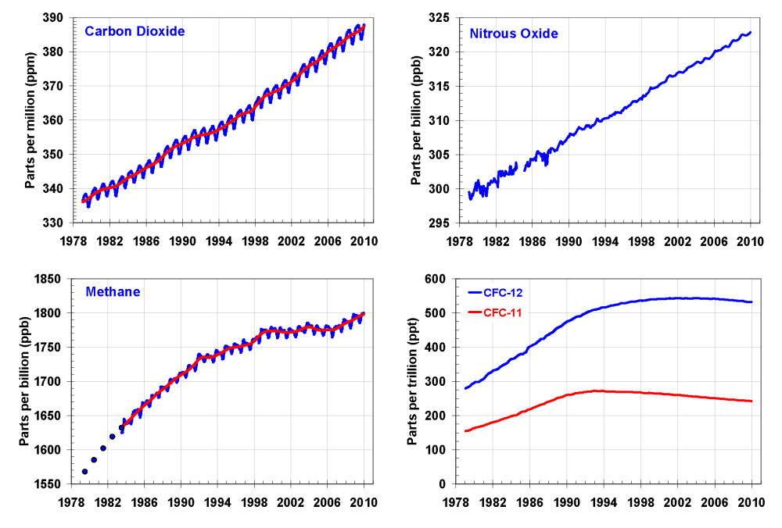
Agriculture’s
share is 62%
Agriculture’s
share is 40%
Nitrous oxide contributes 9% and Methane 18% of Carbon Dioxide equivalent

Slide 74
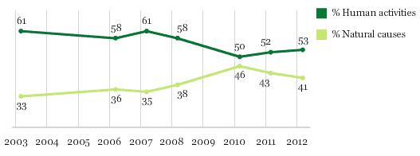
Gallup poll showing percent of U.S. citizens
that believe global warming is caused by
human activities compared to those that think
it is caused by natural causes.

Slide 75
Recent polls and surveys indicate that global warming and climate change, which for several years were the number one environmental concerns, have been replaced by water and air quality. Either way, agriculture remains in the “eye of the storm.”

Slide 76
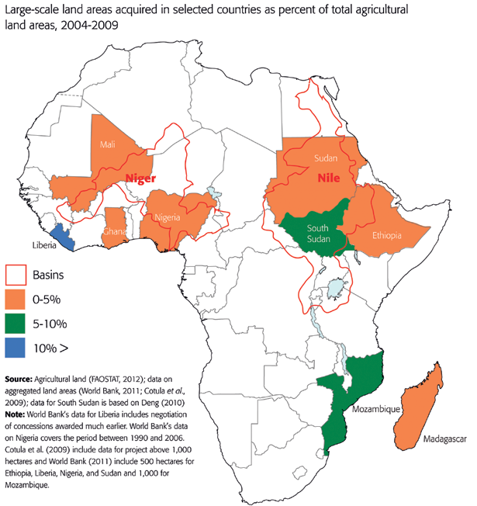
India, China, South Korea, Jordan, Saudi Arabia, United Arab Emirates, Kuwait, and Qatar are investing in large land tracts in Africa to produce food for their own use. All of these are experiencing land and water shortages, at least in parts of their countries.

Slide 77
In summary, I do not want to forecast “doom and gloom.” Quite the opposite ̶ I am optimistic that the problems can be managed, but your generation must be much more SYSTEMS ORIENTED than my generation. As a young researcher in this Department in the 1950s, I conducted some of the early studies with N fertilizer, including the first study ever conducted in Oklahoma using anhydrous ammonia. We looked ONLY at how N increased yield.

Slide 78
We were not dumb, but we were ignorant. We simply had no knowledge that there were negative consequences of using N fertilizer. We only thought of the effect it had on the FIELD and the crop growing on the field. You must think of the SYSTEM, and the system for N includes the ground water, the runoff water, the atmosphere; all of which affect the global environment.

Slide 79
Since the end of World War II, the agricultural community has made great accomplishments. The task you face, however, is a greater challenge than we faced. The problem is simple, but the solution is hard. The world population and their NEEDS AND WANTS are rapidly rising, but the land, water, and energy resources required to meet these demands are in many cases constrained. You must do more with less.

Slide 80
I am optimistic that you will meet these challenges. Long term, I believe energy sources will emerge that are plentiful and less damaging to the environment. If this indeed happens, it could increase water by desalinization. This leaves land and while there is potential for expanding cropland area, too much expansion will result in developing marginal lands that increase environmental problems. Thus, maintaining soil quality is paramount.

Slide 81
I want to end like I started by quoting Churchill because with the challenges ahead, we truly need to do what is right.
“What I like about the American people is that they always do what is right — after they have tried everything else” Winston Churchill

