Slide 1
Oklahoma’s Cropland
>70%

Slide 2
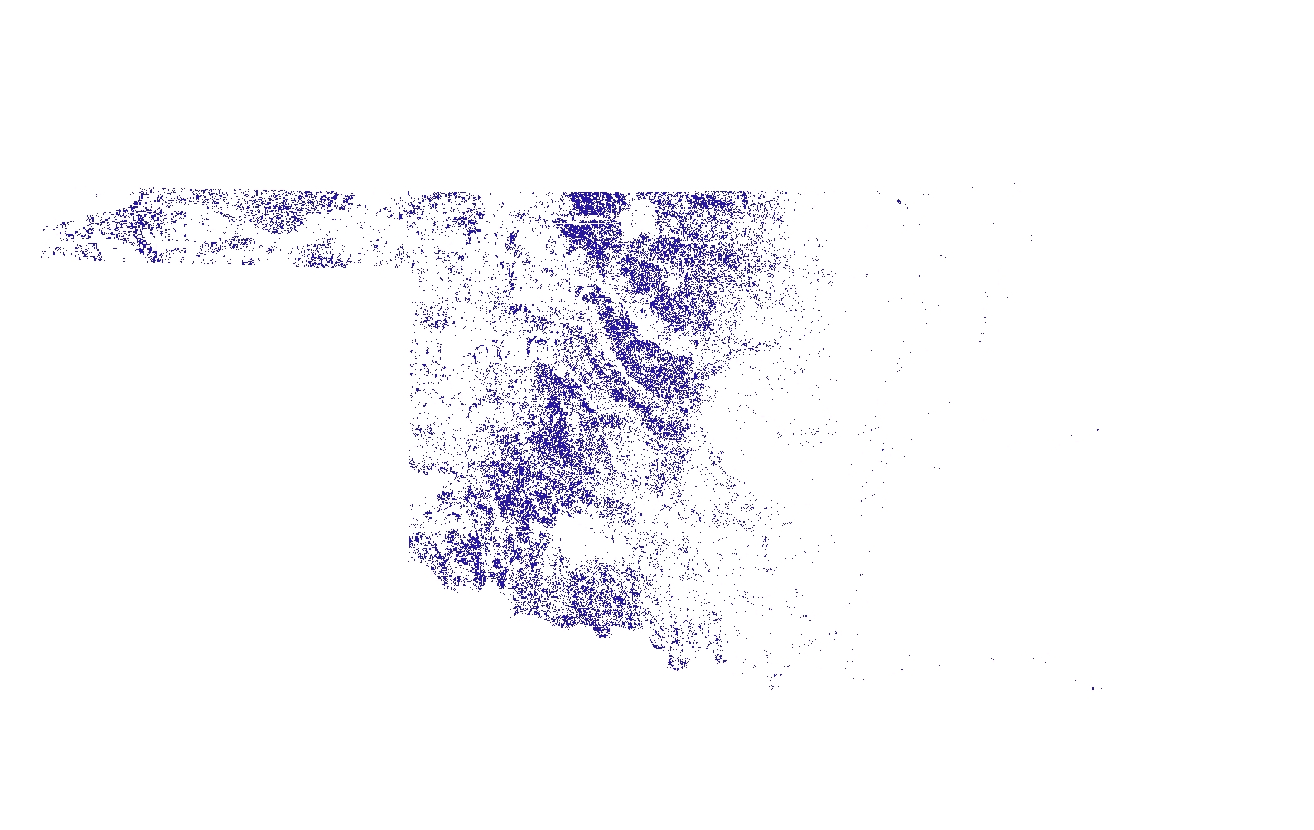
Oklahoma’s Land under Winter Wheat

Slide 3
State average wheat grain yields have remained constant in last 30 years!!

Slide 4
Average Rainfall Central-Western Oklahoma

Slide 5
?

