Slide 1
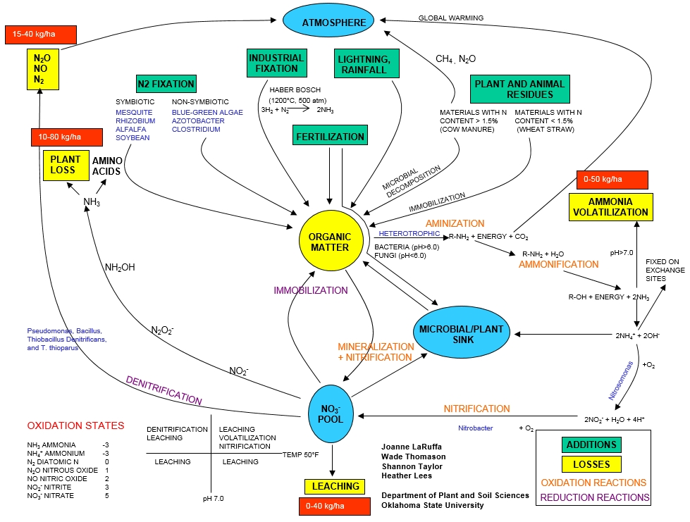
co₂
co₂
Organic matter when broken down releases N into the system at the same time releasing co₂ into the atmosphere. Leaching causes an indirect release of co₂ into the system causing a decrease in oxygen into the aquatic ecosystem. Plant and animal residues release co₂ due to microbial decomposition within the system. The removal of plants or plant loss contribute to co₂ emissions. Last would be the denitrification of N₂ NO N₂O into the system. All the systems contribute to the release of co₂ in the atmosphere.
co₂
co₂
co₂
co₂

