Slide 1
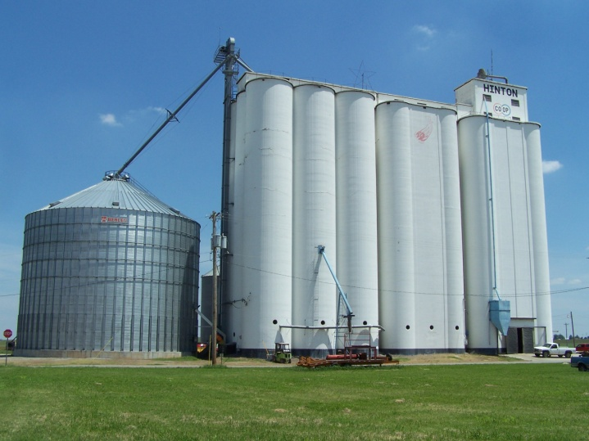
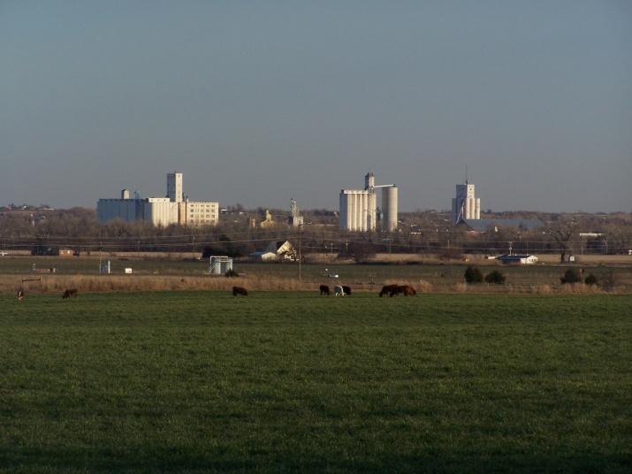
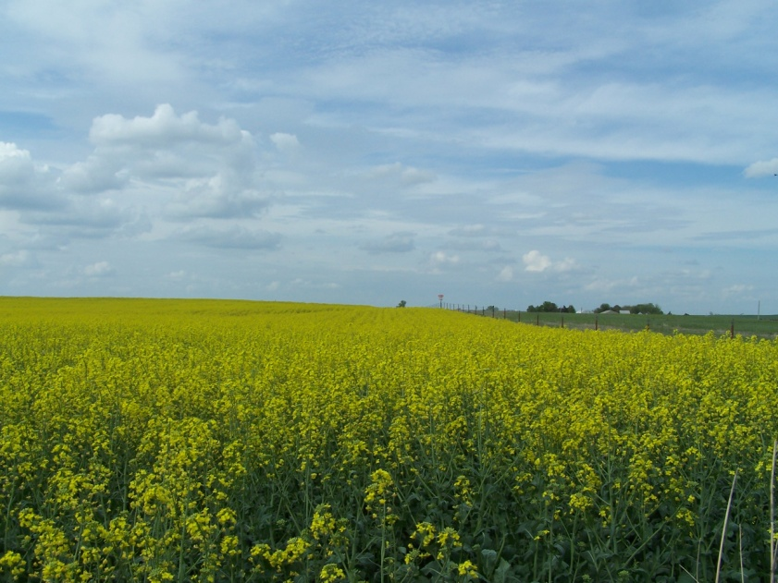
Oklahoma
By: Katlynn Weathers
Wheat Pasture Cattle
Kingfisher, OK
Co-op in Hinton, OK
Farm Facts from 2007 Census of Agriculture
Approximate total land area (Acres) – 43,905,445
Total Farm land – 35,087,269
Crop Land – 13,007,625
Pasture Land – 18,713,085
Average Farm Size – 405 Acres.
Average Age of an OK Farmer is 57
Percent of Oklahoma Farmers with farming as there primary occupation – 41.6%
Men – 75,716
Women – 10,849
Canola Field Okarche, OK
By: Katlynn

Slide 2
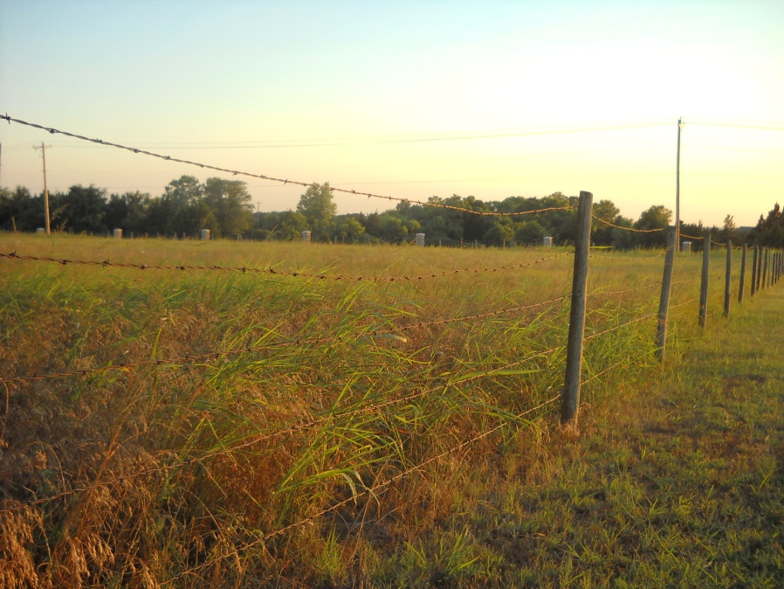
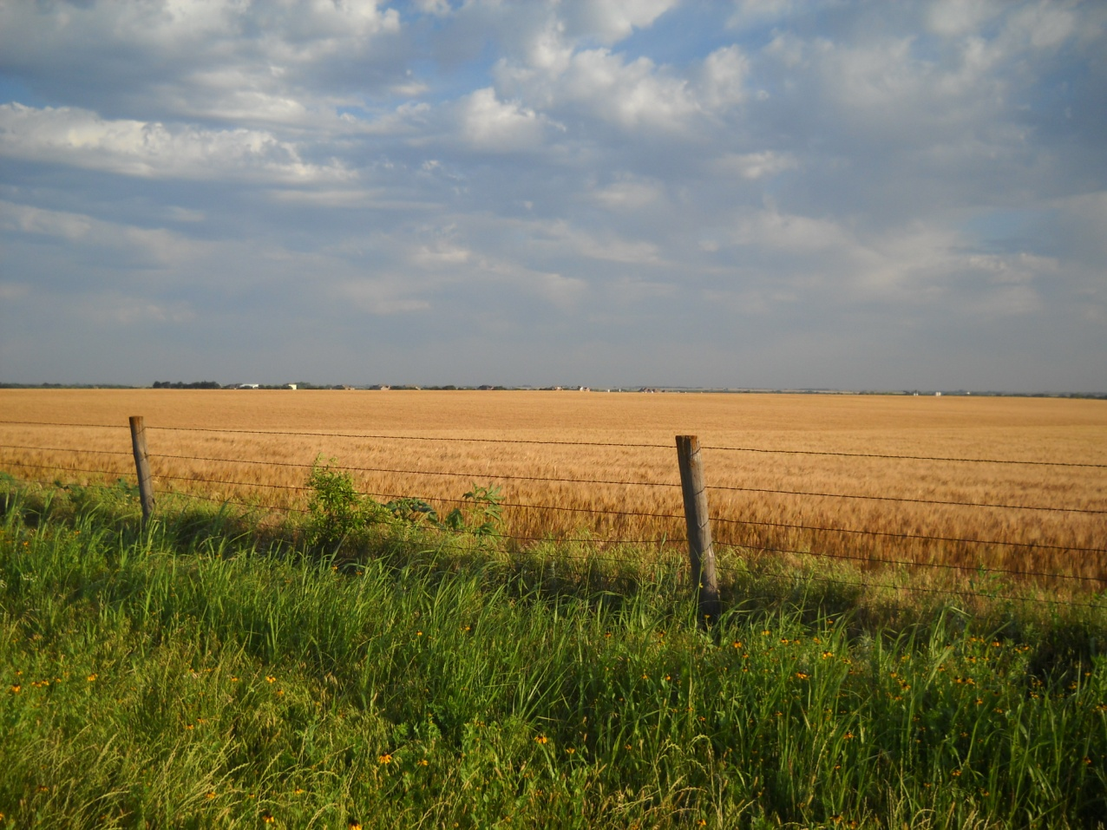
Top Ag Commodities in 2010
Cattle and Calves
Broilers
Hogs
Wheat
Dairy Products
Hay Pasture Edmond, OK
Top 5 Counties in Ag Sales
Texas County
Cimarron County
Le Flore County
Beaver County
Mc Curtain County
Wheat Pasture Piedmont, OK
Acres of farms in OK | % of Farms this size in OK
1 -99 Acres | 42.0
100-499 | 40.4
500-999 | 8.6
1000-1999 | 4.8
2,000 or more | 4.1
By: Katlynn

Slide 3
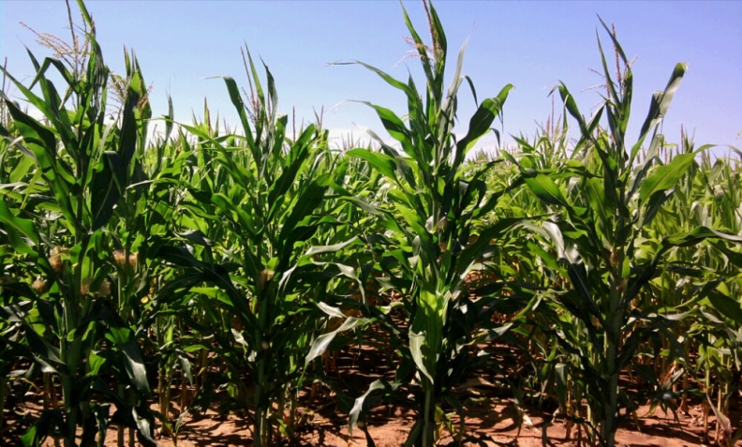
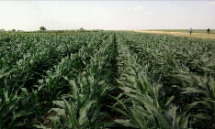

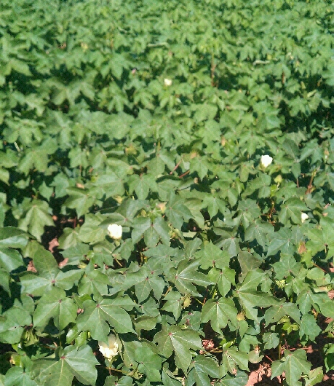
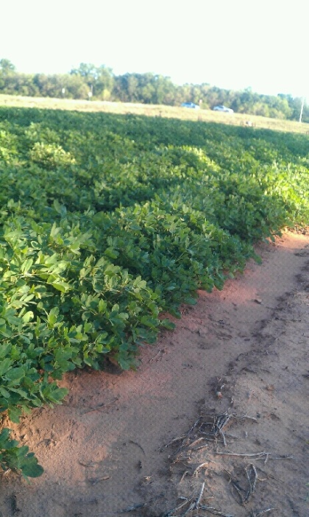
Grain Sorghum Red Rock, OK
Corn Blackwell, OK
Cotton Flower
Cotton Stillwater, OK
Peanuts
Stillwater, OK
By: Katlynn
Notes:
Sources
http://www.agclassroom.org/kids/stats/oklahoma.pdf
Http://www.agcensus.usda.gov/index.php

Slide 4
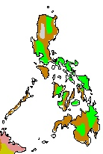
Major Farming Systems in the Philippines
Farming Systems
 | 1. Lowland rice
 | 2. Tree crop mixed
 | 3. Root-tuber
 | 4. Upland intensive mixed
 | 5. Highland extensive mixed
 | 6. Temperate mixed
 | 7. Pastoral
 | 8. Sparse (forest)
 | 9. Sparse (arid)
http://www.fao.org/farmingsystems/FarmingMaps_low/EAP/01/FS/index.html
By: Malou

Slide 5
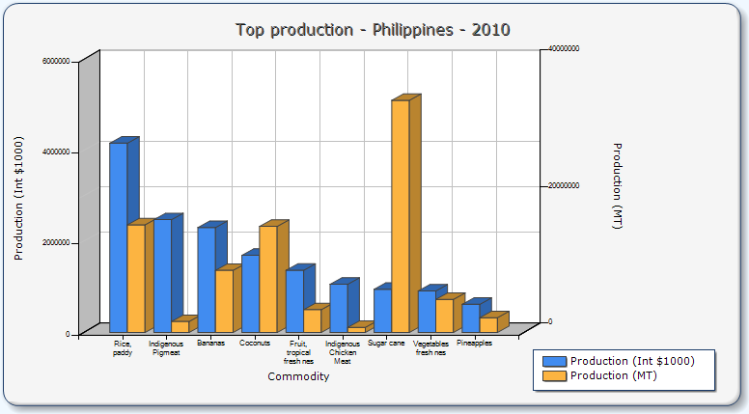
http://faostat.fao.org/site/339/default.aspx
By: Malou

Slide 6
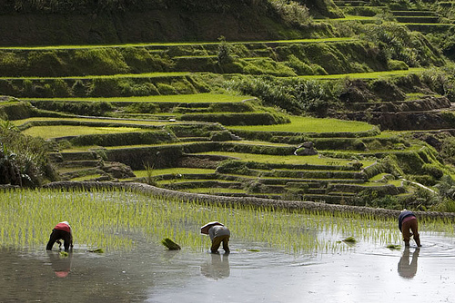
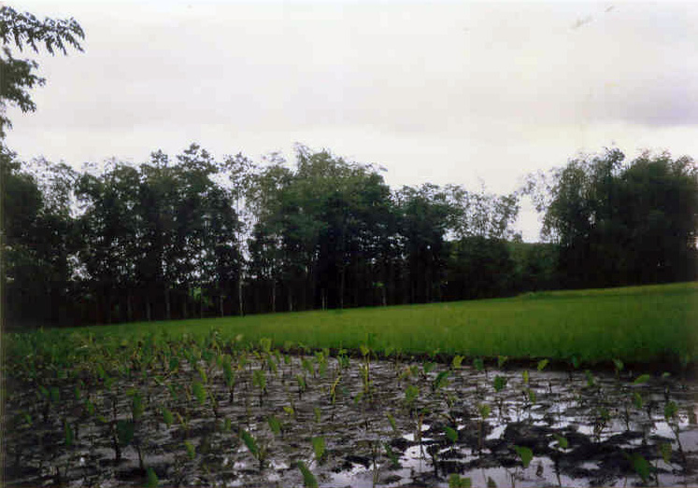
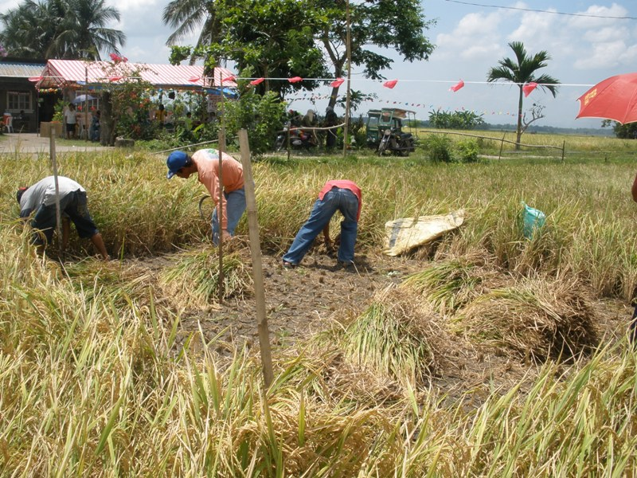
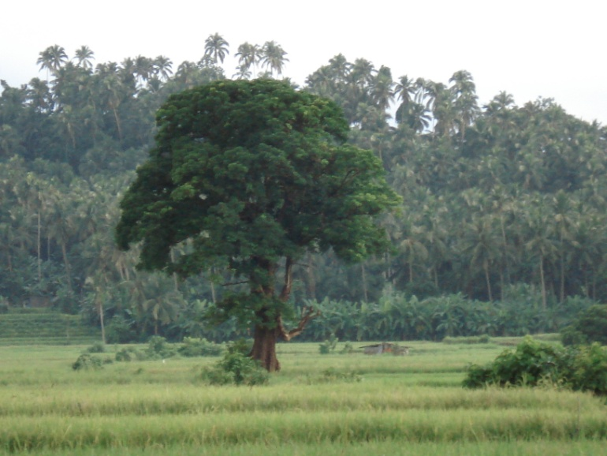
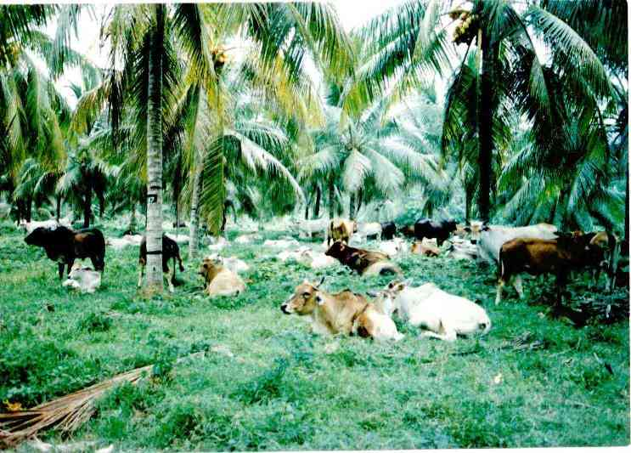
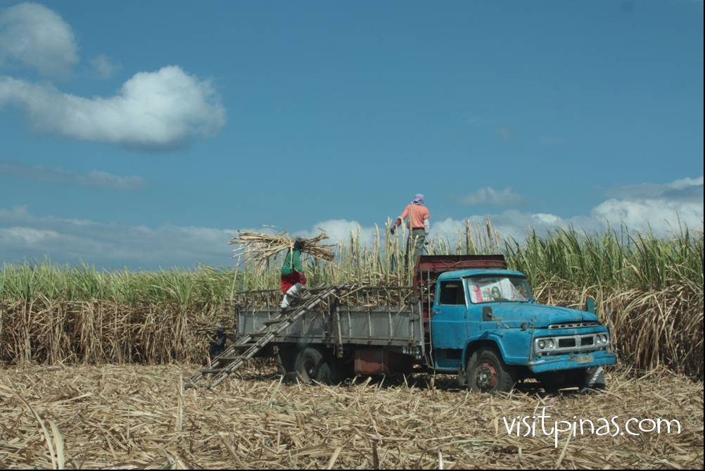
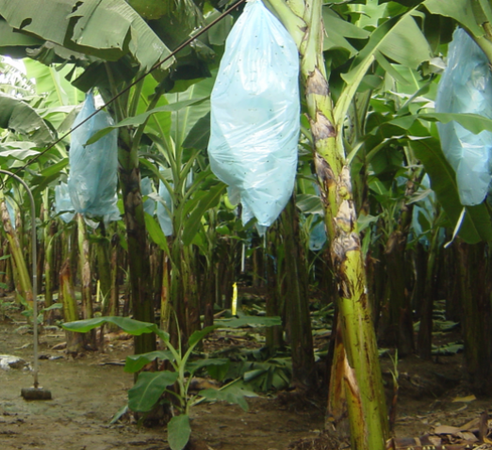
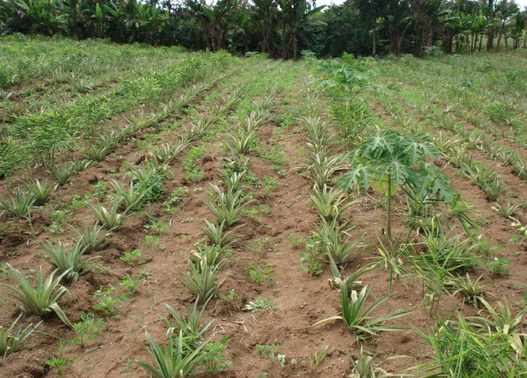
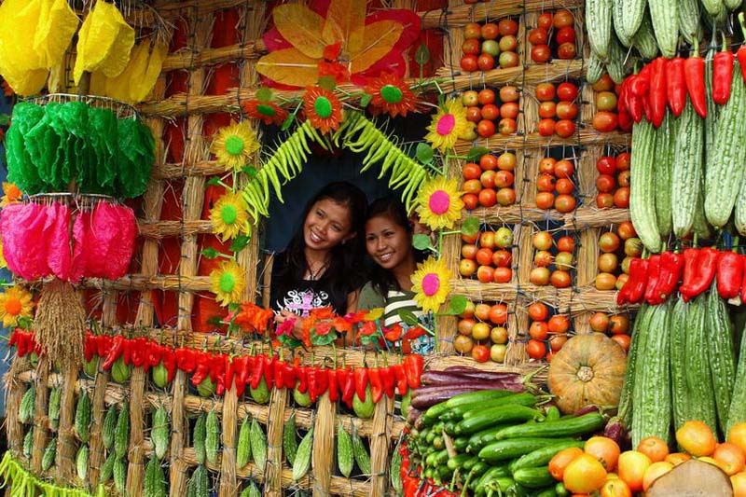
By: Malou

Slide 7
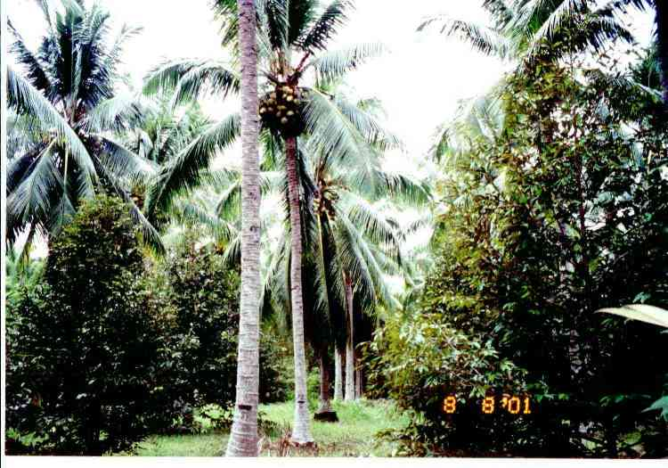
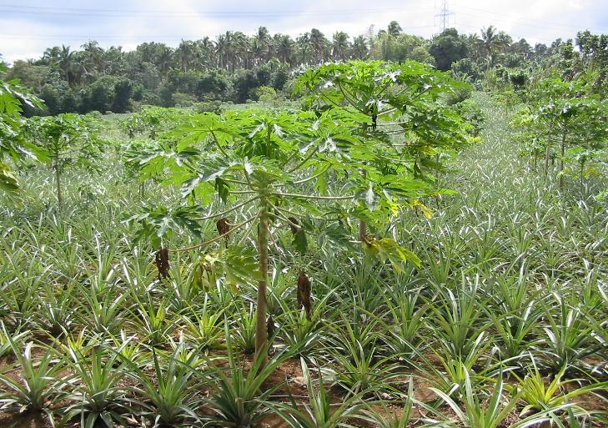
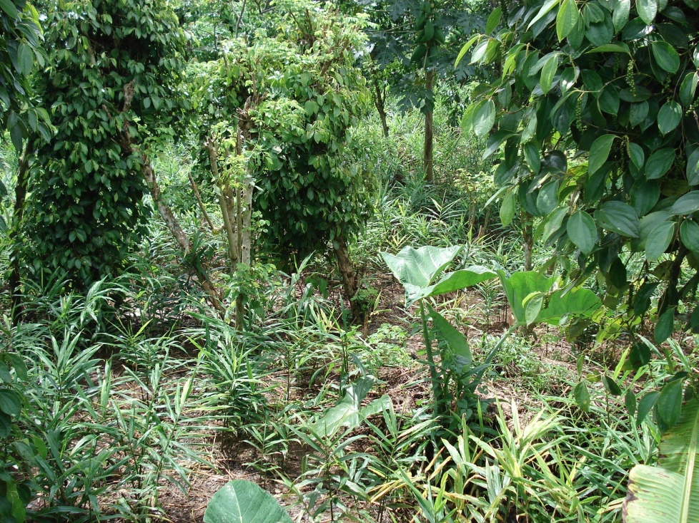
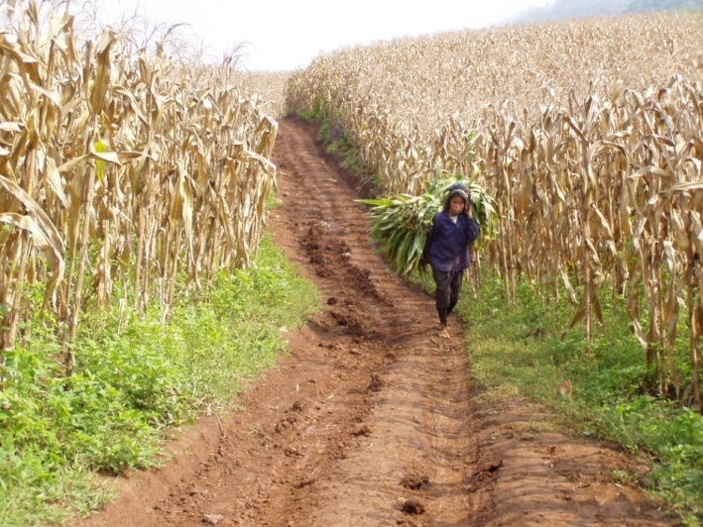
By Malou

Slide 8
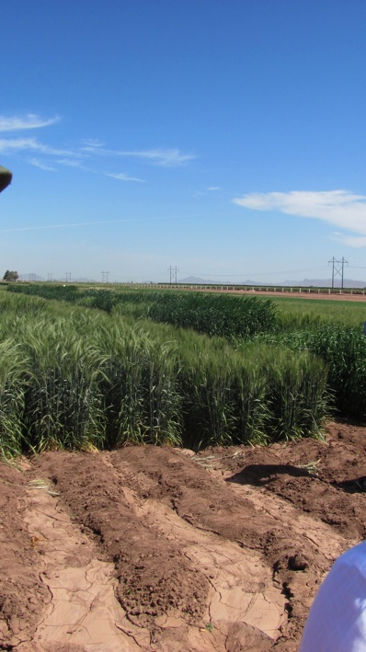
Wheat planted on beds in Mexico.
By: Patrick

Slide 9
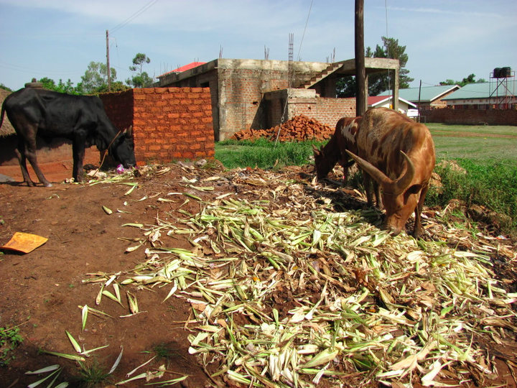
“Feedlot” in Gulu, Uganda
By: Patrick

Slide 10
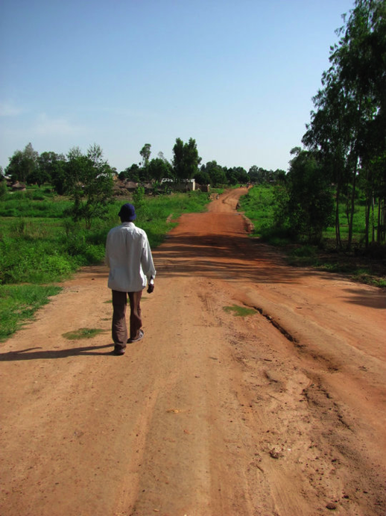
Upland and Lowland Rice Gulu, Uganda
By: Patrick

Slide 11
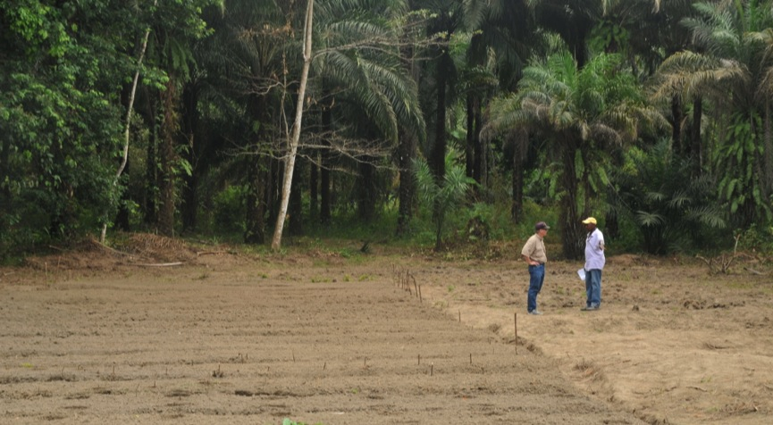
Cassava Research plots McKinney, Sierra Leone
By: Patrick

Slide 12
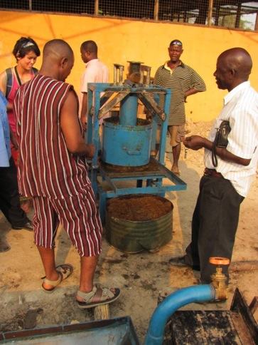
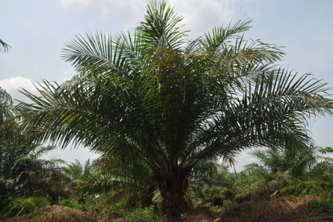
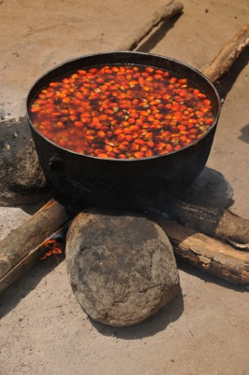
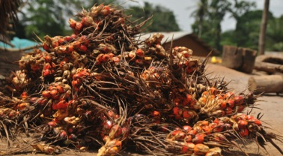
Palm Oil Production Sierra Leone
By: Patrick

Slide 13
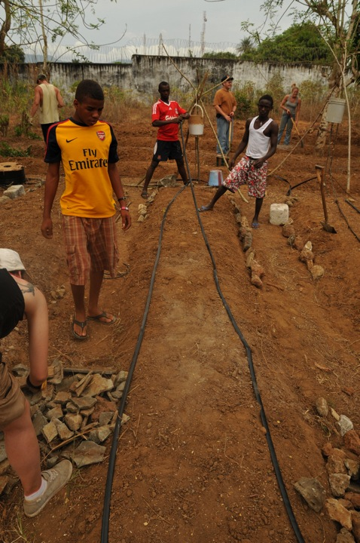
Drip Irrigation Freetown, Sierra Leone
By: Patrick

Slide 14

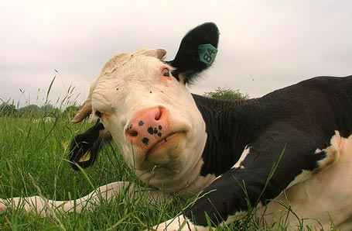
Agriculture in Carter County Oklahoma
The value of livestock, poultry, and their products as a percentage of the total market value of agricultural products sold: 92.66%
Harvested cropland as a percentage of land in farms: 9.28%
The percentage of farms operated by a family or individual: 95.49%
Average size of farms: 318 acres
Average value of agricultural products sold per farm: $17,625
Average value of crops sold per acre for harvested cropland: $43.77
The value of nursery, greenhouse, floriculture, and sod as a percentage of the total market value of agricultural products sold: 0.25%
Average total farm production expenses per farm: $20,851
Average market value of all machinery and equipment per farm: $27,806
Average age of principal farm operators: 56 years
Average number of cattle and calves per 100 acres of all land in farms: 13.90
Milk cows as a percentage of all cattle and calves: 0.21%
All wheat for grain: 1837 harvested acres
Land in orchards: 4,726 acres
http://www.city-data.com/county/Carter_County-OK.html#ixzz1oMBQyzID
By: Josh Pittman

Slide 15
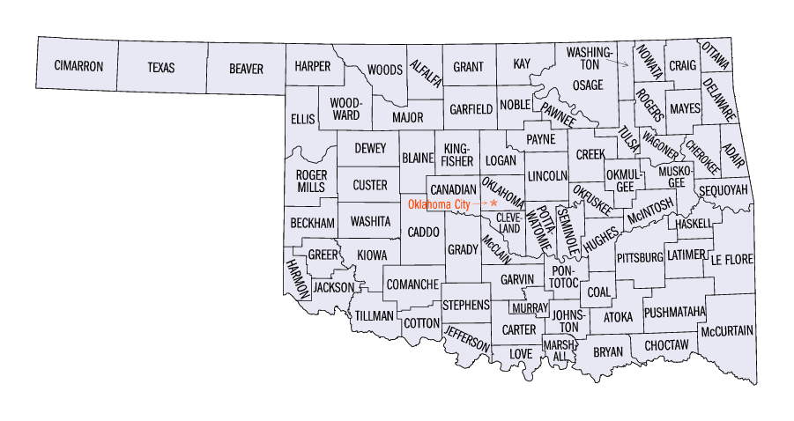

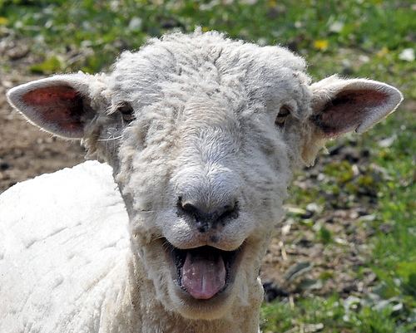
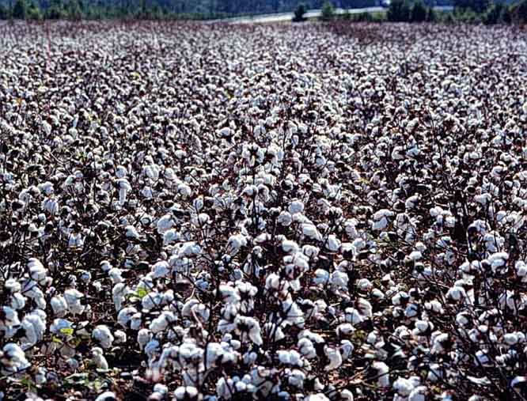
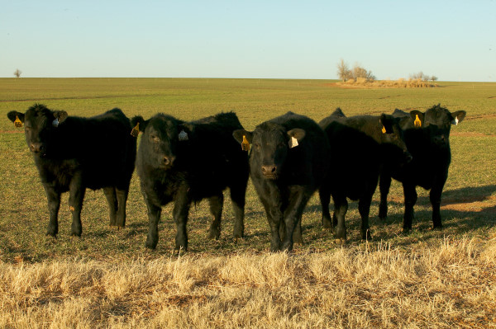
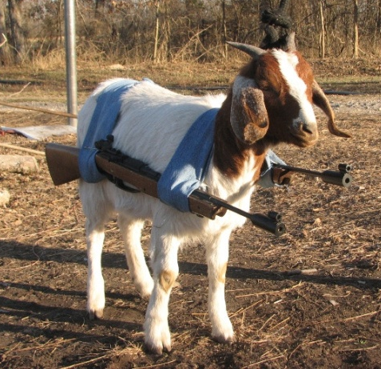
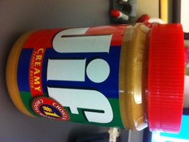
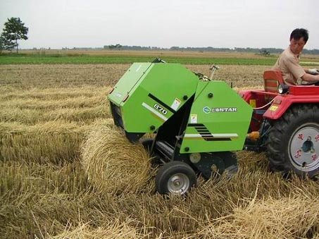
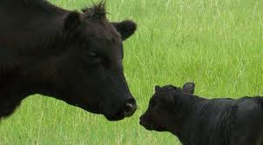
Yes This Is a Sheep
A Long Time Ago in a…..
But not Anymore
Stockers…zzzzzz
Wheat Pasture…zzzzzz
Makin’ a Comeback
Could Be An Import From Love County
BEEF..its what used to be for dinner
Little Bit of Hay
By: Josh Pittman

Slide 16
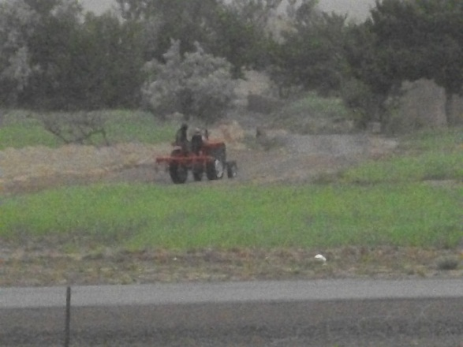
By: Chris Thomas

Slide 17
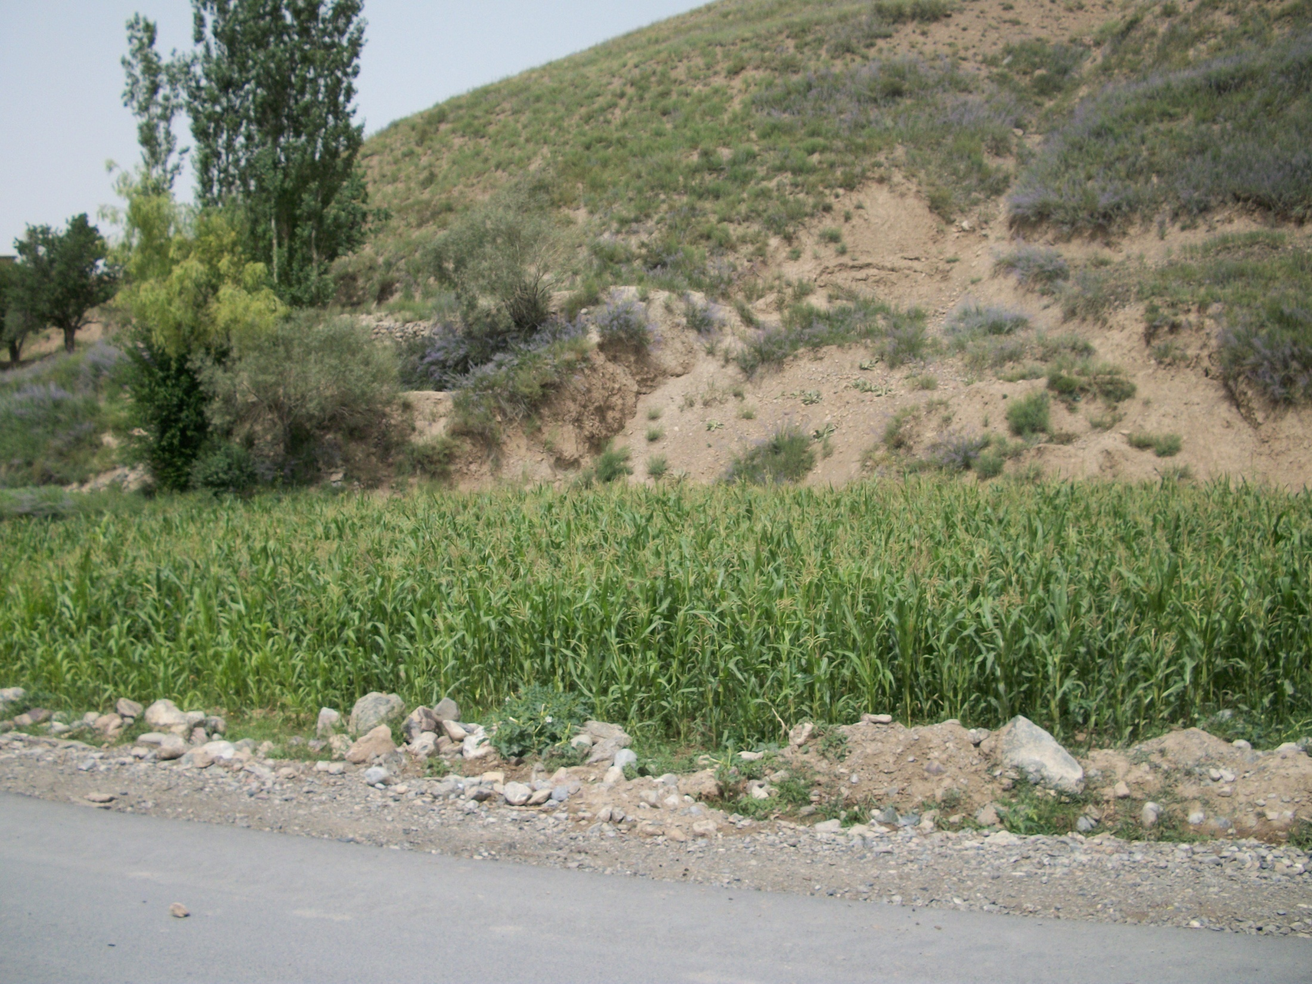
By: Chris Thomas

Slide 18
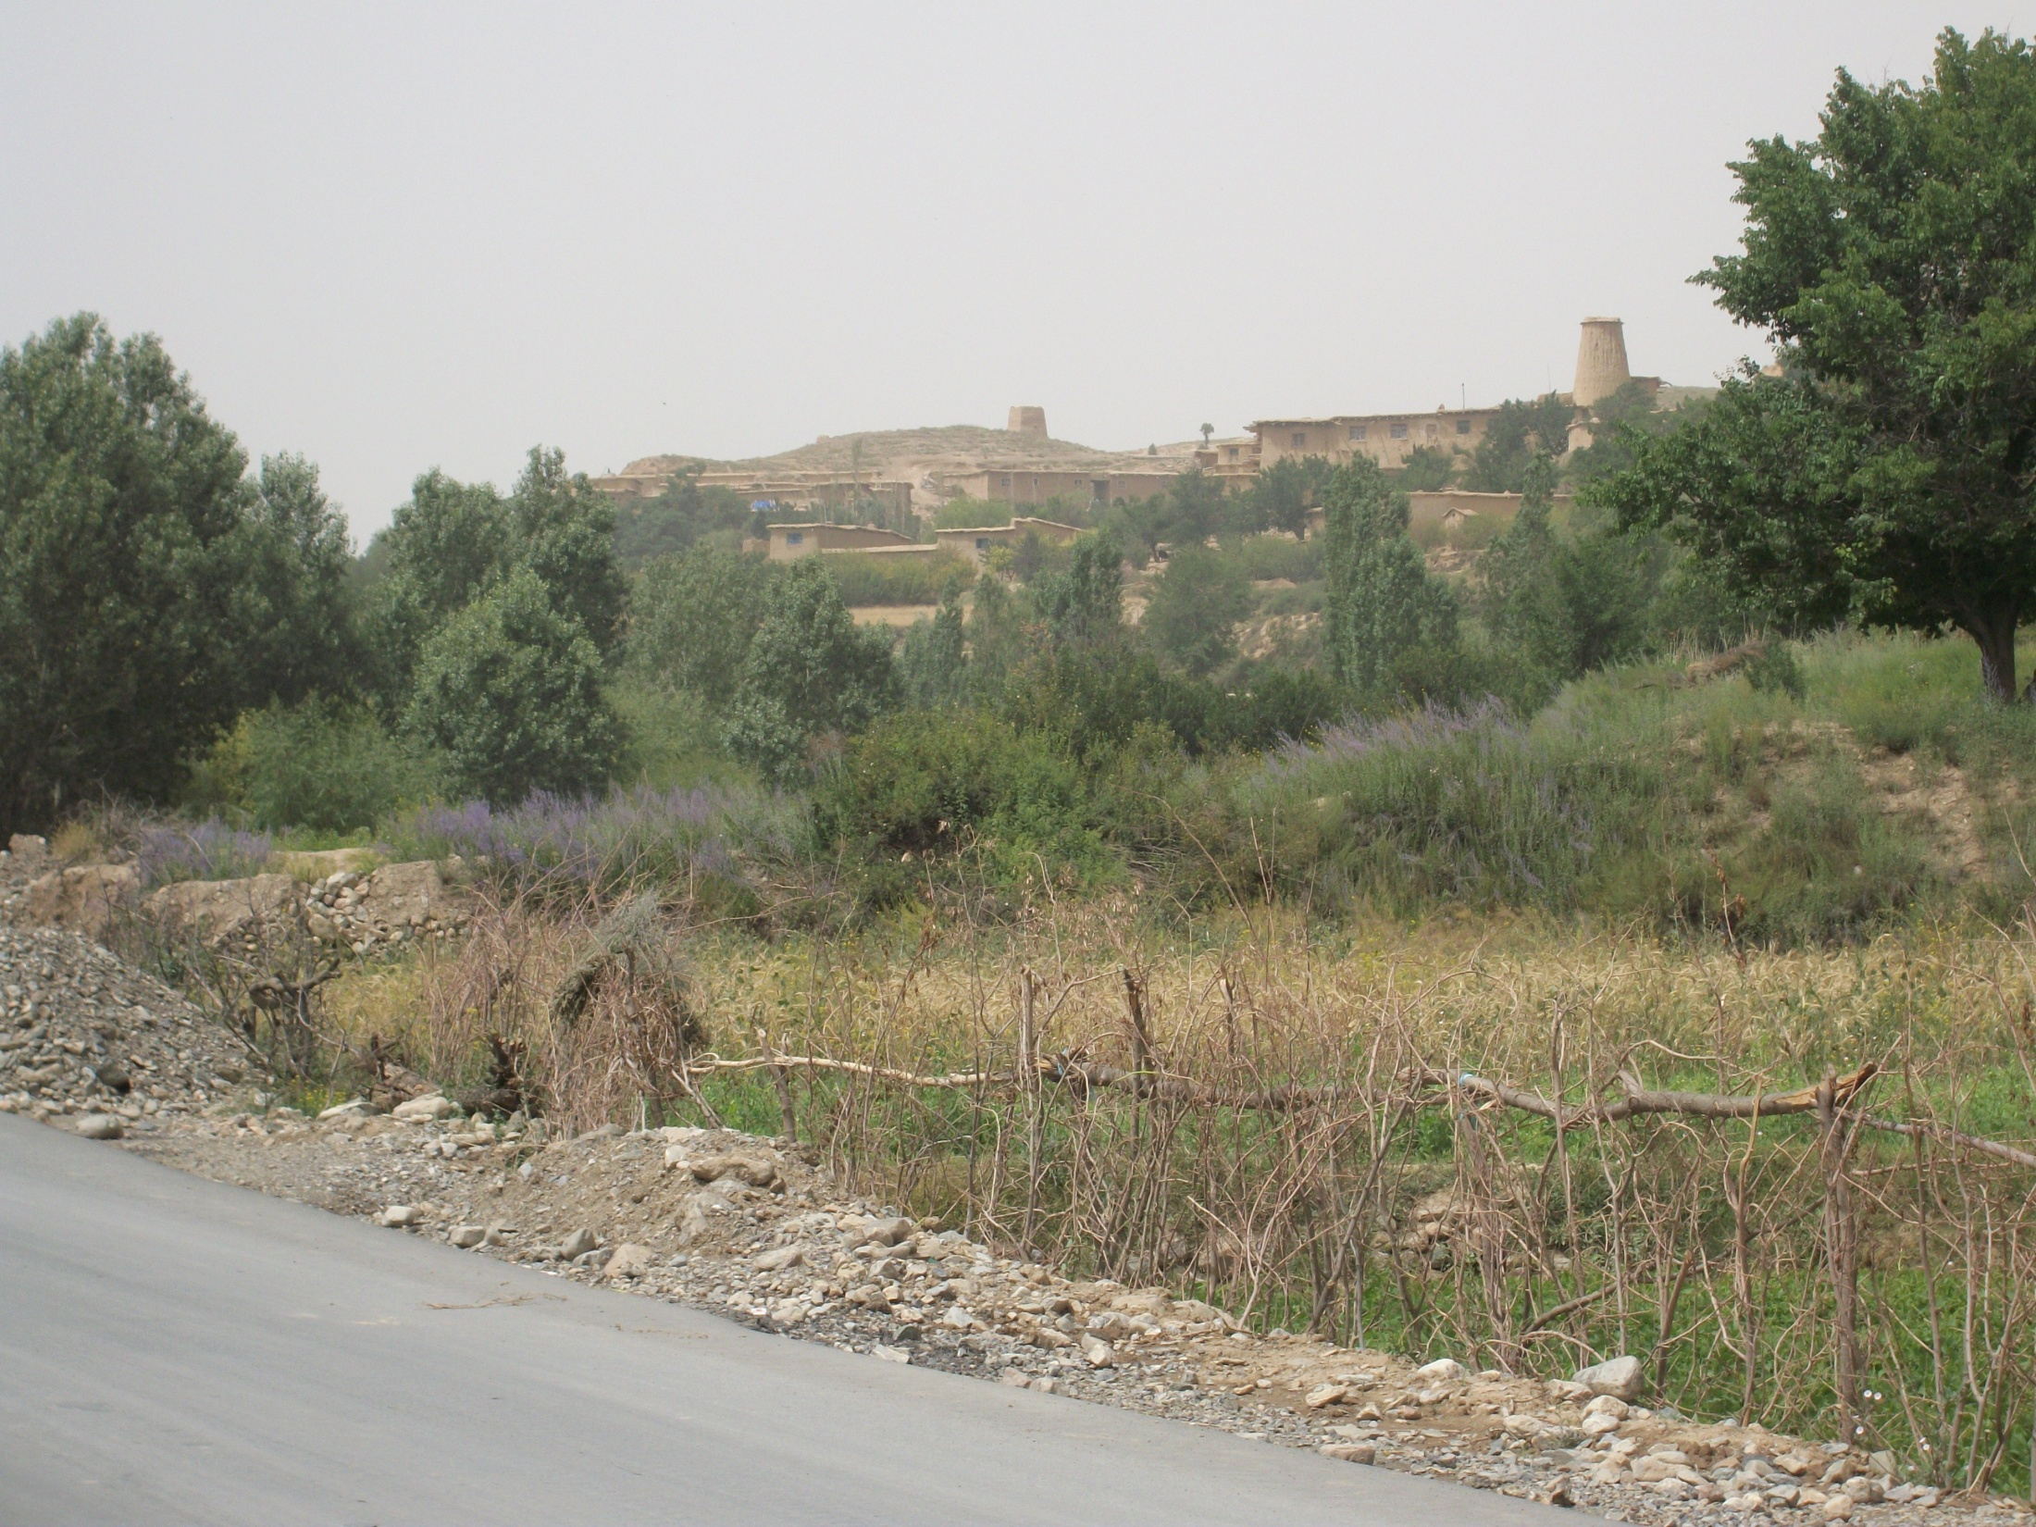
By: Chris Thomas

Slide 19
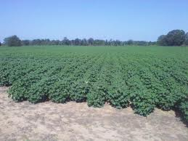
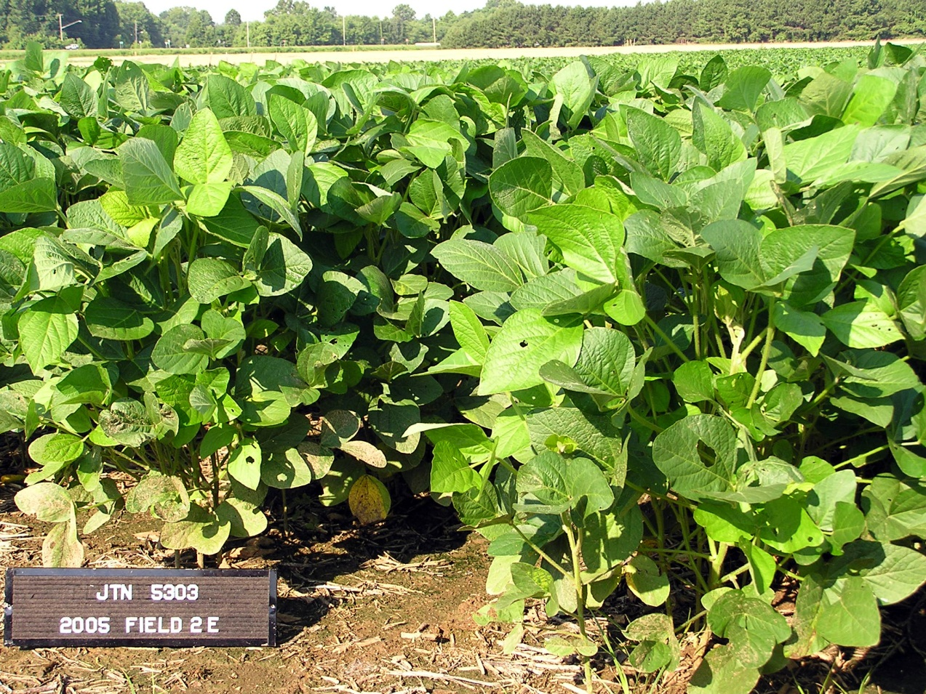
By: Tracy Wilson

Slide 20
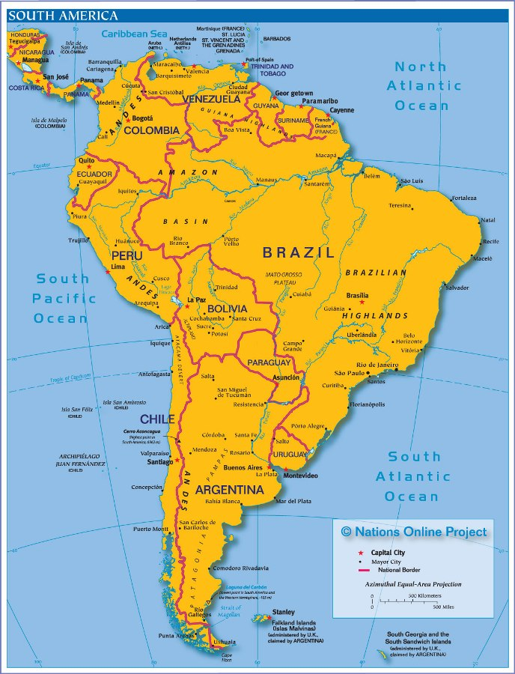
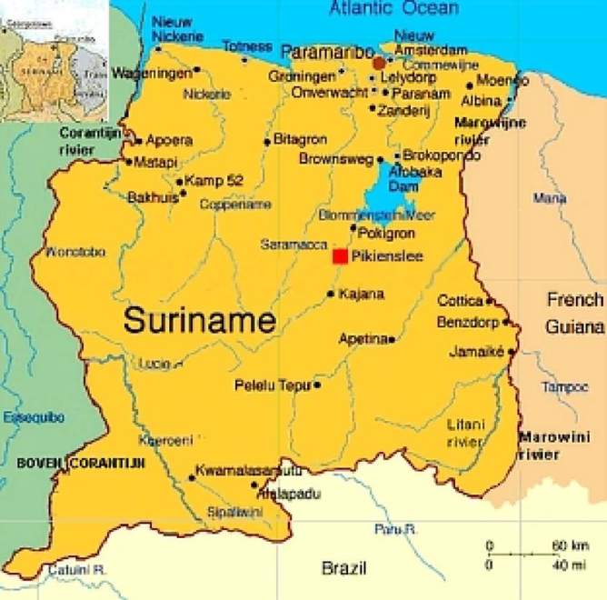
Main Crops
Rice
Banana
Citrus
Vegetables
By: Natasha

Slide 21
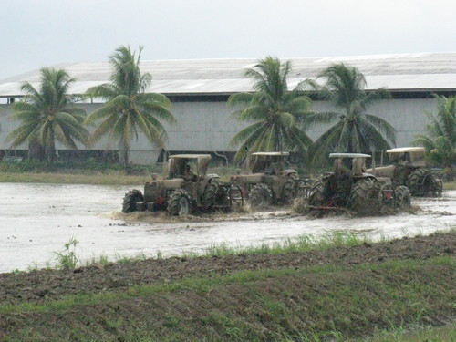



Source:alltravel.com/suriname
Source:devsur.com
Source:panoramio.com
By: Natasha
Rice and Banana production in Suriname

Slide 22




Source: panoramio.com
Source: nederland-suriname.nl
Source: alltravel.com/suriname
Source: flickriver.com
Traditional agriculture -shifting cultivation -in the interior of Suriname
By: Natasha

Slide 23

Minimal Tillage in Sugarcane
By: AJ Foster

Slide 24



California Firm Trial- Leave Curl Problem in Tomato
By: AJ Foster

Slide 25



Fertilizing Pepper plants –Photo taken from Growing Scotch Bonnet Pepper in Jamaica Handbook
By: AJ Foster

Slide 26

By: Michael
Notes:
Winter Wheat

Slide 27

By: Michael
Notes:
Corn

Slide 28

By: Jacob Bushong
Notes:
Cow calf operation on bermudagrass pasture in Custer County, Oklahoma.

Slide 29

By: Jacob Bushong
Notes:
Conservation tillage peanuts Custer County, Oklahoma.
Crop Rotation=Conservation tilled peanuts-> conventionally tilled wheat -> no-till sorghum -> fallow

Slide 30


Indiana
The Hoosier State
Boiler
Fighting Irish
Lance
Sam
“Land of the Indians”
15th most populous state
38th largest state
Considered to be part of:
The Heartland
The Midwest
The Corn Belt
Ambrose and Shepherd

Slide 31
Indiana Agriculture
2007 statistics
14,773,184 acres of farmland
Average farm size: 242 acres
Top Commodities-2010
National Rankings
  1st in duck production
  2nd tomato production (249,000 tons)
  2nd popcorn production
  2nd layer chickens
  4th peppermint production (293,000 lbs)
  4th soybean production (211 million bushels)
  5th corn production (960 million bushels)
Ag Commodity | % State total Farm Receipts | % U.S. Value
Corn | 36.5 | 7.8
Soybeans | 28.3 | 8.2
Hogs | 10.7 | 5.7
Dairy products | 6.1 | 1.9
Chicken eggs | 3.9 | 5.8
http://www.ers.usda.gov/statefacts/IN.HTM-updated 2012
Ambrose and Shepherd

Slide 32
‘Corn Belt’
Indiana
Growing season: 160-190 days
Rainfall: North-36”, South-46”
Avg. land value ($/ac): $4,386-$6,521
Avg. cash rent ($/ac): $141-$230
2011 avg. soybean yield: 42 bu/ac
2011 avg. corn yield: 160 bu/ac
http://www.agecon.purdue.edu/extension/pubs/paer/pdf/PAER8_2011.pdf
http://www.nass.usda.gov/Statistics_by_State/Indiana/index.asp
http://www.ers.usda.gov/statefacts/IN.HTM-updated 2012
Ambrose and Shepherd

Slide 33
Indiana Soil
Covered by 3 glaciers (Kansan, Illinoian, Wisconsin)
Soil types vary around the state
  Top soils: Alfisols, Mollisols, Inceptisols (southern)
  Most of the state is covered in till
  Also areas of muck soils, sand, and outwash
Tile Drainage
  Aquolls
http://www.ers.usda.gov/statefacts/IN.HTM-updated 2012
Ambrose and Shepherd

Slide 34







Tile
Drainage

Slide 35


Ambrose and Shepherd
Notes:
Southern Indiana varies because it was never covered in glaciers, but the melting ice created rivers and hills. Shaped limestone, so caves are only found in the southern part of the state.

Slide 36





Ladoga, IN
Miami silt loam (63% of county)
  Surface: Light brown silt loam 10-15 inches deep
  Subsurface: heavy silt loam to silty clay loam to 30 inches
  C-horizon: glacial till
  Moderately-well drained
  Organic Matter: 2%
Aquoll-Mollisol
4.8% OM
Butler, IN
Blount silt loam (29% of county)
  Surface: dark, grayish brown silty clay loam about 8 inches thick
  Subsurface: dark, yellow brown clay loam 14 inches thick
  C-horizon: brown clay loam 60+ inches
  Somewhat poorly drained
  Organic Matter: 2%
http://ncsslabdatamart.sc.egov.usda.gov/querypage.aspx
Ambrose and Shepherd
Notes:
Rensselaer series-5%

Slide 37

Oklahoma Soils and Farms
Oklahoma Soil:
Port silt loam (Cumulic Haplustolls)
  Occurs in about one million acres in 33 counties
  Deep, well-drained, highly productive
  Suited for a wide range of crops including alfalfa, small grains, sorghum, cotton as well as range, pasture, and woodlands
  Usually reddish
Farms in Oklahoma
Number of Farms | 86,500
Land in Farms (acres) | 35,200,000
Average Farm Size (acres) | 407
Farms in Oklahoma County
Number of Farms | 1,289
Land in Farms (acres) | 159,823
Average Farm Size (acres) | 124
Alex Cumbie 2012
From USDA Census of Agriculture

Slide 38

Oklahoma Commodities
Top Commodities (2010):
Cattle and calves $2,178 million
Poultry and eggs $812 million
Hogs and pigs $658 million
Winter wheat $617 million
All hay $510 million
Corn for grain $212 million
Cotton and cottonseed $201 million
Milk production $173 million
Soybeans $132 million
Grain sorghum $70 million
Alex Cumbie 2012

Slide 39


Kevin Meeks
Lubbock, Texas
Home of Texas Tech University
Where Cotton is KING
2010 Cotton Facts for Lubbock County from the USDA NASS website
Irrigated Acres: 158,500 ac planted, avg yield 970 lb/ac, 320,000 bales produced
Dryland Acres: 114,500 ac planted, avg yield 575 lb/ac, 136,100 bales produced
Total Production: 273,000 acres planted, 456,100 bales produced (1 bale=500 lbs)
Lubbock county was one of six counties in the US to reach more than $100 million in cotton sales in 2007
By: Kevin Meeks

Slide 40



Agricultural Commodities
Home to the Texas Corn Producer Board & Corn Producers Association of Texas
Home to the National Sorghum Producers
Home to Texas Peanut Producers Board
By: Kevin Meeks

Slide 41



Agricultural Commodities
Home to multiple vineyards, wineries and cellars
Home to many beef cattle feed yards and processing plants
By: Kevin Meeks

Slide 42

Dewey County
AVERAGE:
Rainfall – 28”
Temperature – 58 F
Wesley Hedges

Slide 43
Dewey County
STATISTICS
29.5% Crop Land
66% Pasture and Range Land
4.5% Other uses
Average farm size is 779 acres
USDA 2007
By: Wesley Hedges
(2007 Census of Agriculture)

Slide 44
Dewey County
CROPLAND: Wheat, Canola, and Alfalfa
PASTURE & RANGE: Cow/calf, Bermuda grass, Triticale, and Rye.
No-Till Farmers:
  Crops: Milo, Sunflowers, Sesame, Soybeans, and Corn.
USDA 2007
By: Wesley Hedges

Slide 45
Agriculture in Ethiopia
Foundation of the county’s economy. About half of GDP,
> 85% exports, and around 85 % employment
Principal crops - include a variety of cereals, pulses, oilseeds, and coffee. Principal grains are teff, wheat, barley, corn, sorghum, and millet.
Environment and man made factors cause widespread and severe food insecurity
Agriculture in Ethiopia is typically low-input and subsistence oriented
Few % of the farmers uses fertilizer
Traditional methods of farming
By: Yohannes Yimam

Slide 46



Agriculture in Ethiopia
By: Yohannes Yimam

Slide 47


Southwest Oklahoma
By: Robert Calhoun

Slide 48


Dual Purpose Production
By: Robert Calhoun

Slide 49

By: Robert Calhoun

Slide 50



By: Jared Crain

Slide 51

Himalayas
Mid-hills
Low-hills
Plains
By: Sulu and Kundan

Slide 52

By: Sulu and Kundan
Notes:
Terrace farming is a common practice in mid-hills of Nepal. Agriculture in this region is rainfed and subsistence. Paddy is usually grown up to 1400 m above sea level. Major crop in this region include wheat, maize, and millet.
Image source from top to bottom
http://mlhuynh.files.wordpress.com/2007/10/nepal_terracing.JPG
http://wpcontent.answcdn.com/wikipedia/commons/thumb/2/23/Millet_fields_in_Annapurna.png/240px-Millet_fields_in_Annapurna.png
http://www.swiss-cooperation.admin.ch/nepal/en/Home/pictures/nepal/nrm/en_maize_hill.jpg
http://1.bp.blogspot.com/-h7U6nq2E4EY/TkvOlbL2SPI/AAAAAAAAPCs/_9sHv8rv4aA/s1600/800px-Planting_Paddy_Nepal.jpg

Slide 53

By: Sulu and Kundan
Notes:
Southern Nepal is characterized by plains. This region is also known as the bread basket of the country. Soils in these regions are alluvial and very fertile. Crops grown in this region include rice, maize, sugarcane, mustard etc. Access to irrigation and market has facilitated commercial agriculture in this region.
Image sources:
http://www.everestuncensored.org/Hiking/07202008/thumb/43%20Agriculture%20%20%20Its%20still%20the%20main%20occupation%20of%20Nepal.jpg
http://www.everestuncensored.org/Hiking/07202008/thumb/43%20Agriculture%20%20%20Its%20still%20the%20main%20occupation%20of%20Nepal.jpg
http://2.bp.blogspot.com/-c8jj8pjdU4M/TcF5okzlEjI/AAAAAAAABug/atXfxhvlkhA/s1600/IMG_0487a+%2528Custom%2529.JPG

Slide 54


Slide 55

Agricultural-Iraqi Kurdistan region
By: Bayar Amedy

Slide 56


Agricultural-Iraqi Kurdistan region
Agricultural role in Kurdistan region goes beyond food production; it’s the second-largest sector in the Kurdistan economy.
Arable land in Kurdistan: 28% of its total area
Major agricultural crops:
- Cereal (wheat, barely and rice).
- Oil seeds and industrial crops ( sesame,
sunflower and cotton).
- Legume ( green beans, lentil).
- Vegetable (tomato, watermelon,...).
Tillage: conventional and zero till.
By: Bayar Amedy

Slide 57



Agricultural problems in Kurdistan and Iraq
Kurdistan: swelling and shrinking of soil.
Iraq (south): Soil salinity problem.
By: Bayar Amedy

Slide 58



Soils
By: Romulo
Source: Coelho et al., 2002.
38 % Oxisoils
High [Fe3+]
High [Al3+]
Low [Base Cations]
Very Low P content
Source: FAO

Slide 59














Soybeans
Mato Grosso ~20M tons soybeans
Parana ~14M tons soybeans
Rio Grande do Sul ~11M tons soybeans
~50-55% of national
soybean production
By: Romulo

Slide 60








Corn
Central West Region
Drought risk
31 inches
~13Mt of 2st season corn (65%)
South Region
~17Mt of 1st season corn (50%)
By: Romulo

Slide 61






Wheat
High input wheat (irrigated, heavy N fertilizer, high yields)
~4.5Mt of total wheat (95%)
By: Romulo

Slide 62


Argentina
North to South
Main ag area: 22ºS to 39ºS:
~ Mexico DF to Kansas City, Ks
Growing season 300 days (N) to 180 days (S)
East to West
Soils Clay, Silt-clay loam to sandy (Vertisols – Molisols – Entisols)
Rainfall 58” to 20”
SOM 6 to 1.0%
No snow or frozen soils
By: Andres

Slide 63

No-Till evolution in Argentina (1977-2005)
By: Andres
50
45
40
35
GMO
30
Area (Million acres)
25
AAPRESID
20
15
10
5
0
1977/78
1986/87
1988/89
1990/91
1992/93
1994/95
1996/97
1998/99
2000/01
2002/03
2004/05
2010 estimation: 60 M acres 81% of total Ag area (75 M Acres)
Notes:
63
As the figure shows, No till in Argentina has developed since AAPRESID’s foundation at a very rapid rate, even before GMO crops adoption.
Two years ago, there was already almost 20 million hectares under NT, that represent about 70% of the total cropped area.

Slide 64
Fertilization is based on N, P, S.
Average age of producers is much lower than US.
Excellent interaction among Public + Ag firms
+ technicians + farmers
Farmers receive an average 70% of international grain prices due to export taxes
No-till + Certified Agriculture: It is considered the evolution of no-till. Consists in the certification of a given field, which must follows proper good ag practices (GAP) and documentation as the foundations for continuous improvement of agricultural system.
Generalities
By: Andres

Slide 65




Variable rate application
Frequent monitoring
Intensive diversify cropping systems
Active interaction among farmers and consultants
By: Andres

Slide 66

Agriculture in Japan
In Japan, 60 % of food is imported from other countries.
-20 % of food such as wheat, corn and soybeans are from U.S.
-When corn price was increased a box of batter cost $10 in Japan
The regulation for GMO food is really strict in Japan
-For example, it is required to label as “GMO based product” if a product contains GMO.
Average farm size is 1.2 ha (it is 200 ha in U.S.) and average farmer's age is 68 years old.
Due to the limited land area and high production cost (fuel =$6 per gallon , majority of fertilizer are imported), vegetable and fruit production has been intensively investigated (higher market value compared with grain).
By: Yumiko

Slide 67


Malaysia
Weather: tropical climate
Average temperature: 23-32°C
Average rainfall: 2500-2800mm
Major Tree crop: rubber, palm oil, rice, and fruits, eg. pineapple, rambutan, durian
By Bee

Slide 68













http://www.youtube.com/watch?v=qh9TP0Vzc1k&feature=related
By Bee

